Slide 1
POSTGRADUATE STUDIES IN COVENANT UNIVERSITY PROCESSES AND EXPECTATIONS The Place of Wisdom
Professor Abiodun H. Adebayo
Dean, School of Postgraduate Studies
Covenant University
abiodun.adebayo@covenantuniversity.edu.ng

Slide 2
OUTLINE OF PRESENTATION
Introduction
NUC Approved Postgraduate Programmes
Registration of Courses
Graduation Statistics in the Last 5 Years
Admission Screening Procedures
Expected Programme Schedule
Levels of Postgraduate Examination
Regulations on Failed Courses
Appointment of Mentors and Supervisors
Who Can Teach and Supervise a PG Student? And Supervision Quota
Publication Requirement
Result Upload
Conclusion

Slide 3
INTRODUCTION
From the inception, the Proprietors of Covenant University noted the prime position of postgraduate training for the overall success of the institution and the rapid development of the nation.
These realities led to the proposal to Senate on November 26, 2003 to establish the School of Postgraduate Studies.

Slide 4
VISION
To be a leading centre for postgraduate training for the needs of contemporary Africa.
Mission
To produce very high quality postgraduates by engaging best practices in programme, research and services, deploying life applicable, life promoting as well as cutting-edge techniques in our services and delivery.

Slide 5
NUC APPROVED POSTGRADUATE PROGRAMMES
Total Number of Approved Programmes:
M.A, M.Sc, M.Eng- 34
MBA/MPA- 5
M.Phil- 28
Ph.D- 34

Slide 6
Current Programmes Include:
M.Sc/M.Phil/Ph.D Accounting
M.Sc/M.Phil/Ph.D Banking and Finance
M.Sc/MBA/ M.Phil/Ph.D Business Administration
M.Sc/M.Phil/Ph.D Ind. Relations & Human Resource Mgt
M.Sc/MBA/M.Phil/Ph.D Marketing
M.Sc/M.Phil/Ph.D Demography and Social Statistics
M.Sc/M.Phil/Ph.D Economics
M.Sc/Ph.D Mass Communication

Slide 7
M.Sc/M.Phil/Ph.D Sociology
M.Sc/M.Phil/Ph.D International Relations
M.Sc/M.Phil/Ph.D Political Science
M.Sc/MPA/M.Phil/Ph.D Public Administration
M.A/Ph.D Counseling
M.Sc/Ph.D Psychology
M.A/Ph.D English
M.A/Ph.D French
M.Eng/M.Phil/Ph.D Civil Engineering
M.Eng/M.Phil/Ph.D Computer Engineering
M.Eng/M.Phil/Ph.D Electrical and Electronics Engineering
M.Eng/M.Phil/Ph.D Information and Communication Engr
M.Eng/M.Phil/Ph.D Mechanical Engineering

Slide 8
M.Eng/M.Phil/Ph.D Chemical Engineering
M.Eng/M.Phil/Ph.D Petroleum Engineering
M.Sc/M.Phil/Ph.D Architecture
M.Sc/M.Phil/Ph.D Building Technology
M.Sc/M.Phil/Ph.D Estate Management
M.Sc/M.Phil/Ph.D Biology
M.Sc/M.Phil/Ph.D Biochemistry
M.Sc/M.Phil/Ph.D Microbiology
M.Sc/M.Phil/Ph.D Industrial Chemistry
M.Sc/M.Phil/Ph.D Management and Information Systems
M.Sc/M.Phil/Ph.D Biochemistry
M.Sc/Ph.D Industrial Mathematics
M.Sc/M.Phil/Ph.D Industrial Physics

Slide 9
GRADUATION STATISTICS IN THE LAST 5 YEARS

Slide 10
ADMISSION SCREENING PROCEDURES
Mode of Assessment
Written Examination (CBT)- 50%
Quantitative and Verbal Reasoning, English, Mathematics, Programme based, Research based, Core-Value based, etc
Oral Examination- 50%
Spirituality, Appearance, Knowledgability, Comportment, and Research Proposal.

Slide 11
PROCEDURES FOR ORAL SCREENING
The Department shall constitute a panel made up of HOD and the Departmental PG Committee to review and recommend to College PG Board.
Committee to review the applications, certificates and subject combination of prospective candidates.
The College PG Committee shall review the recommendations from the Departmental PG Committee and make recommendations to the SPS.

Slide 12
These minutes shall be duly signed with the names and designation of all.
Reports are expected to be forwarded to SPS within 48 Hours after the oral screening.
Applicants are expected to score at least 50% in each of the exam to be eligible.
Admission is inconclusive without transcripts.

Slide 13
REGISTRATION OF COURSES
A candidate must register at the beginning of every academic session all through the period of studentship.
Any student who fails to register for an academic session is deemed to have voluntarily withdrawn from the postgraduate programme.
No student shall be allowed to proceed to any stage of the programme without proper registration.

Slide 14
DEFERMENT OF ACADEMIC ACTIVITIES
All cases of deferment shall be taken on its own merit.
Students are adviced to process their applications through their HODs to SPS at the beginning of session.
Proof of payment of the prescribed School fees should accompany the application.

Slide 15
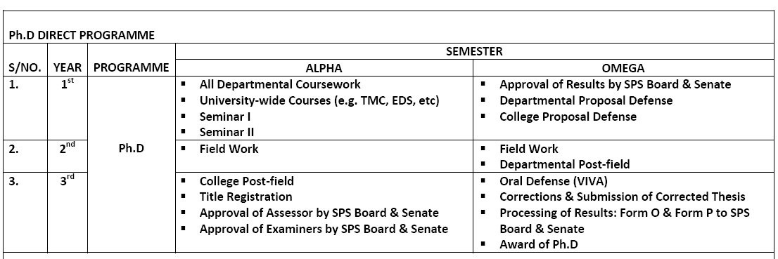
EXPECTED PROGRAMME SCHEDULE

Slide 18
LEVELS OF POSTGRADUATE EXAMINATIONS
Coursework Examinations
Proposal Defence
Postfield Defence
Oral Examinations

Slide 19
Coursework Examinations…
The Deans, College, Departmental Coordinators and SPSB Committee on Examinations are expected to monitor the conduct of these examinations.
The HODs are the Chief Examiners and are expected to monitor the conduct of the examination and ensure that the examination process is followed.

Slide 20
Examination Processes Cont’d
HODs should note that All Questions must be vet by the External Examiners and copies of his reports must be sent to Dean, SPS immediately after the vetting exercise.
It is expected that marking of the scripts be done within the stipulated timeframe (not later than 2 weeks)

Slide 21
The Departmental PG Board meets within the stipulated timeframe (Not more than 2 weeks after the examinations) to consider the results.
Results are keyed-in within the stipulated timeframe.
A Complete Result would be expected to be vetted by the External Examiner.

Slide 22
Approval of Coursework Results
The HOD shall at the end of the coursework compile the approved results by the Departmental PG Board and forward same to the Dean, SPS through the College Coordinator and College Dean.
The Committee of the SPS shall consider the result and recommend same to the Senate of Covenant University for approval.

Slide 23
Proposal Defence
The Proposal Defence for Masters shall be handled by the Department but monitored by the College.
HODs shall forward to SPS the Departmental PG Board, list of recommended Supervisors for Masters’ Dissertations.
Such list must be accompanied with minutes of Meetings and signed by Board members.

Slide 24
M.Phil/Ph.D Proposal Examinations
Approval of Supervisors must have been established by Senate through SPS (Please see the PG Handbook for details).
Departmental Proposal Defense must have been conducted (Please see the PG Handbook for details).

Slide 25
M.Phil/Ph.D Proposal Defence
Copies of the proposal shall be sent to all the approved examiners by the HOD at least 7 days before the date of the proposal defence.
All lecturers in the Professorial cadre must also be given a copy of the written proposal at least 7 days to the date of the proposal defence.
Each of the examiners must submit a written report on the proposal to the Dean, SPS.

Slide 26
M.Phil/Ph.D Proposal Defence Cont’D
The SPS representative must be physically present at the proposal defence (not by proxy).
Absence of the SPS representative renders the proposal defence invalid.
All other approved examiners must be present at the proposal defence. In the event of absence of any of the examiner, the HOD shall inform the Dean, SPS.
The absence of only one examiner, except the SPS representative, shall not void the outcome.
Notes:
NOTE THAT ASKING SOMEONE ELSE TO RESPRESENT YOU IN ANY EXAM IS NOT ACCEPTABLE AND WE MUST DESIST FROM SUCH. IF YOU ARE NOT GOING TO BE AVAILABLE FOR ANY EXAMINATION, PLEASE KINDLY NOTIFY THE DEAN SPS AT LEAST 7 DAYS SO ADEQUATE ARRANGEMENT CAN BE MADE

Slide 27
M.Phil/Ph.D Proposal Defence Cont’D
The result of the examination must be a consensus opinion of the panel of examiners.
The signed report of proposal defence must reach the School of Postgraduate Studies within 72 hours after the examination.
The Committee of the School of Postgraduate Studies shall consider the report and recommend same to the Senate of Covenant University for approval.

Slide 28
POST-FIELD EXAMINATION
The student is considered ready for the Ph.D Post-Field defence only after a successful presentation of the Post-field seminar in the Department.
All lecturers from the rank of Senior Lecturer in the Department shall be given a copy of the research synopsis (30 - 50 pages) at least seven days to the date of the post- field seminar.
The synopsis shall be an abridged Ph.D. thesis.

Slide 29
The Head of Department shall at the satisfactory presentation of Departmental post-field seminar by the student forward to the Dean, SPS.
The Committee of the SPS shall consider the examiners and appoint a representative of the SPS for the post-field defence.

Slide 30
POST-FIELD DEFENCE
Copies of the Ph.D synopsis (30 - 50 pages) and Thesis shall be forwarded by the HOD to all the approved examiners at least 7 days before the date of the post-field defence.
All lecturers in the Professorial cadre in the Student’s Department shall also be given a copy of the Ph.D synopsis at least 7 days to the date of the post-field defence.

Slide 31
All the approved examiners must submit a written report on the synopsis to the Dean, SPS through the College Coordinator and College Dean.
The reports of the examiners shall be forwarded by the Head of Department to the Dean, SPS.
The Head of Department and Student’s supervisors shall ensure that the corrections are satisfactorily effected.

Slide 32
The SPS representative must be physically present at the post-field defence (not by proxy).
Absence of the SPS representative renders the post-field defence invalid.
SPS Representative must submit a report to the PG School.

Slide 33
PhD Oral Defence/Viva Voce:
A copy of the Ph.D thesis shall be sent to the external examiner and other members of the panel of examiners.
Each examiner shall return to the Dean, SPS their report of the assessment of the thesis.
The external examiner’s report and at least one internal examiner’s report of the assessment must be positive for the candidate to be considered for oral defence.
A date shall be fixed for the oral defence of the thesis once the received reports are positive.

Slide 34
The external examiner and the SPS representative must be in attendance physically (not by proxy) before the oral defence can be regarded as authentic.
All other approved examiners must be present at the proposal defence.
In the event of the absence of any of the examiner, the HOD shall inform the Dean, SPS.
Absence of only one examiner, save the external examiner or the SPS Rep, shall not void the outcome.

Slide 35
The result of the examination must be a consensus of the panel of examiners.
The signed report of the oral defence must reach the Dean, SPS on or before 72 hours after the examination.
The Committee of the SPS shall consider the report and recommend same to the Senate of Covenant University for approval.

Slide 36
REGULATIONS ON FAILED COURSES
A Master’s student can not have more than two failed courses upon completion of the coursework.
Good Standing
To be in good standing, a student must in each semester have a GPA of not less than 3.00 for the Master’s Programme.
Any Master’s student with less than 3.00 CGPA after the first year shall not proceed to the Next Stage and shall withdraw from the programme.

Slide 37
A Ph.D student is said to be on a good standing if he/she has a GPA of at least 4:00 upon the completion of the coursework which is usually a semester.
Any student who fails to meet this requirement shall not proceed to the next stage and shall be withdrawn from the programme.

Slide 38
Candidate admitted in the M.Phil/Ph.D programme with less than 4:00 CGPA cannot continue with the Ph.D programme but can proceed with a dissertation in the 2nd year and shall be awarded a terminal M.Phil degree.

Slide 39
Appointment of Mentors and Supervisors
Mentors are appointed for students who have duly registered in the Alpha semester.
HOD make a recommendation to the Departmental PG Board for consideration.
The list of the Mentors are forwarded through the College Dean to Dean SPS with minutes of the Meeting.

Slide 40
After the Coursework examinations, the HOD shall make recommendations for appointment of Supervisors to the Departmental PG Board for consideration for students on good standing.
The recommended list of the Supervisors are forwarded through the College Dean to Dean SPS with minutes of the Meeting.

Slide 41
SPS Board will approve the list for the Master’s students and letters of appointment are subsequently issued to the Supervisors by SPS.
For the PhD Supervisors, the recommendations of the SPS Board will be forwarded for Senate consideration and approval. The Registrar will issue Letters of appointment.

Slide 42
WHO CAN TEACH AND SUPERVISE A PG STUDENT?
The 136th Senate approved the category of faculty who can teach and supervise at the postgraduate level.
*LI with a minimum of two years’ experience
**SL with experience as Co-supervisor

Slide 43
Supervision Quota
The maximum students a faculty can supervise at the postgraduate level is FIVE (5).
However, any Department that wishes to exceed this limit for some faculty members must apply to SPS for consideration.

Slide 44
PUBLICATION REQUIREMENTS
Publication of research findings in conference proceedings and journals indexed in Clarivate Analytics or SCOPUS is a graduation requirement for all students on the Master’s and Ph.D programmes.
Master’s candidate must publish a minimum of two research papers.
A publication in the relevant University based journal maybe accepted for candidates in the Master’s programme.

Slide 45
The Ph.D candidate must publish a minimum of three research papers in Clarivate Analytics or SCOPUS indexed outlets (two papers in conference proceedings and one in a journal or one paper in a conference proceeding and two in a journal).

Slide 46
RESULT UPLOAD
Henceforth, only results uploaded and spreadsheet generated from the portal system shall be acceptable by SPS.
CSIS is helping out to automate all our results which is similar to the undergraduate format.
Details will be communicated to all HODs and Graduate Coordinators.

Slide 47
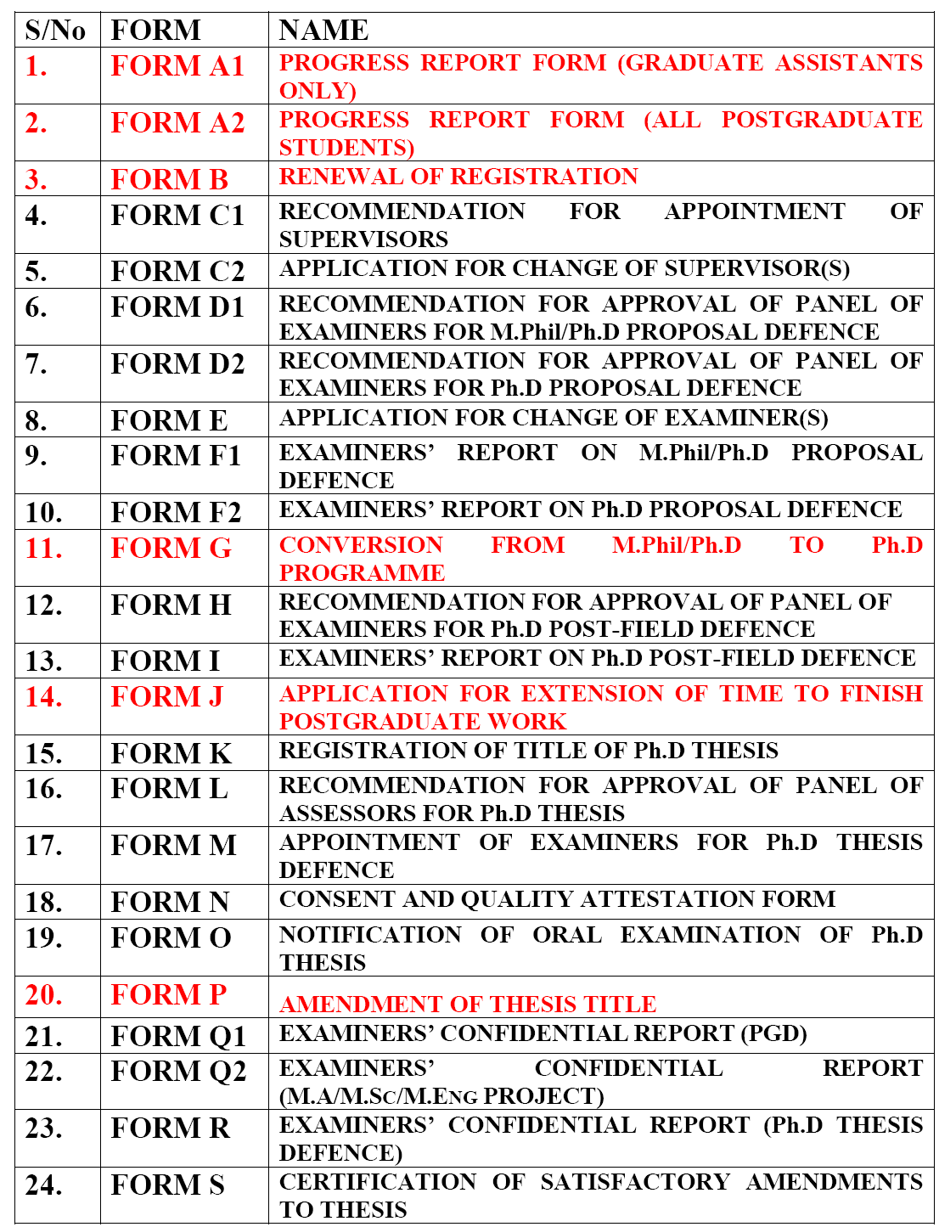
REVISED SPS OPERATIONAL FORMS - Senate approved (141st Senate) - Commence with effect from 2018/2019

Slide 48
CONCLUSION
Our offices are always opened to all should you have any concern.
Let us all Join Hands together and realize our Vision 10-2022.
Remember, the Path of the Just is as a Shinning Light that Shines More and More until the Perfect Day!

Slide 49
THANK YOU
FOR
LISTENING

