Slide 1
Covenant University, Ota Executive Advance
August 2018
COVENANT UNIVERSITY CORE VALUES:
FOUNDATION FOR THE ATTAINMENT OF VISION 10:2022
Presented By: Dr. David O. Oyedepo
Chancellor, Covenant University

Slide 2
THE STORY OF A BOAT BOY AND AN OLD-TIMER

Slide 3
A story was told of an old-timer, who was out sailing on the sea towards the sunset.

Slide 4
The old-timer picked up a floating leaf and asked if the boat boy knew anything about Botany.

Slide 5
The boy replied, “No sir”, and the old-timer said, “Young man, you just lost 25% of your life!”

Slide 6
The old-timer again picked up a rock, from the bottom of the boat, and with a punctilious look at the rock, he again asked the boy, if he knew anything about geology.

Slide 7
The boy replied, “No sir.” Again, the old-timer replied, “You have lost another 25% of your life.”

Slide 8
The old-timer gazed at the sky, night fall was closing in, and stars were already dotting the sky. He turned to the boy and asked, “Do you know anything about astronomy?”

Slide 9
“No sir”, the boy replied and the old-timer said, “That makes 75% of your life that you have lost.”

Slide 10
As the old-timer was delivering his verdict on the young man’s life, a great storm arose.

Slide 11
The boat started drifting out of control. The young man turned to the old-timer and asked, do you know anything about swimming?

Slide 12
The old-timer said, “No”. The young man said to him, “Sir, you have just lost your entire life!” And immediately, the young man dived into the sea and swam to the shore, leaving the old-timer to his fate.

Slide 13
This story simply illustrate the fact that learning about life is more vital than learning about things.

Slide 14
THE ANCHOR VISION OF COVENANT UNIVERSITY

Slide 15
To be a leading world-class University, committed to raising a New Generation of Leaders in all fields of Human endeavours.

Slide 16
OUR 3-FOLD MANDATE

Slide 17
“To raising a new generation of leaders through a qualitative and life-applicable training system that focuses on value and skill development.”

Slide 18
“To raising a new generation of leaders through a broad based qualitative education built on sound biblical principles culminating in the birth of path-finders, pace-setters and trail-blazers.”

Slide 19
“To raising a new generation of leaders who shall redeem the battered image of the black race and restore her lost glory as these trained army of reformers begin to build the old waste, repair the wasted cities and raise the desolation of many generations.”

Slide 20
Our Founding Philosophy
A departure from ‘Form’ to ‘Skill’
A departure from ‘knowledge’ to ‘empowerment’
A departure from ‘figures’ to ‘future-building’

Slide 21
A departure from ‘legalism’ to ‘realism’
A departure from ‘points’ to ‘facts’
A departure from ‘mathe-matics’ to ‘life-matics’.

Slide 22
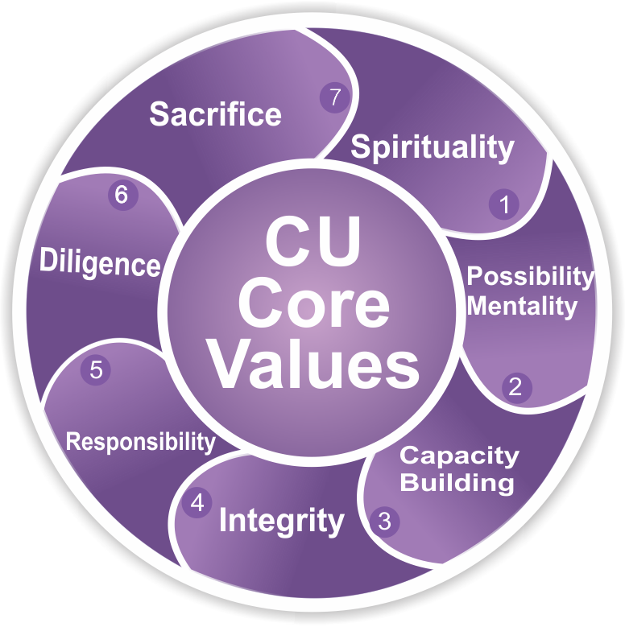
OUR CORE VALUES

Slide 23
SIMCaRDS
S – Spirituality
I – Integrity
M – Possibility Mentality
Ca – Capacity Building
R – Responsibility
D – Diligence
S – Sacrifice

Slide 24
Our Core Values
The platform of the implementation of our Vision and Mission is our core values
Our Core Values are the principles that constitute the creed that defines us as a University

Slide 25
SPIRITUALITY
1
Here at Covenant University, Spirituality is the core of our core values.
We recognize spirituality as an asset of inestimable value – Rom. 8:6

Slide 26
Spirituality guarantees all-round profiting – 1Tim. 4:7-8
The spiritual root of a number of world class universities authenticates this claim.

Slide 27
1. Harvard University, the oldest institution of higher learning in the US, was originally founded to train ministers of the Gospel in 1636.

Slide 28
Harvard made it a basic rule for learning that every student must understand that the knowledge of God and Jesus Christ is the only foundation for all sound knowledge and learning.

Slide 29
2. Princeton University demanded that every student attend worship in the College Hall MORNING and EVENING at the hours appointed and that they must behave with gravity and reverence during service. It was also mandatory for every student to attend Sunday service.

Slide 30
3. Yale University Founded on Christian doctrine and actually instructed her students to obtain the clearest conception of divine things and enforced concrete regulations to lead them to a saving knowledge of God in His son Jesus Christ.

Slide 31
4. Columbia University
Columbia University would not accept any student that could not render in English the gospel from Greek.

Slide 32
All of these show the quality of Christian-based education all through history.
America, today, owes her sustaining values to these institutions.

Slide 33
Unfortunately, most of these universities have lost their spiritual root and no wonder God is raising new institutions today to replace them.

Slide 34
Possibility Mentality
2
Possibility mentality is key to a world of unlimited possibilities.

Slide 35
As no one ever arrives at a future he cannot see – Gen. 13:14-15
In like manner, no one ever arrives at a future he is not prepared for – 2Chr. 27:6

Slide 36
The more spiritually enlightened we are, the greater our capacity to believe all things – Acts 24:14

Slide 37
CAPACITY BUILDING
3
Capacity can be defined as a commitment to develop relevant skill in the pursuit of a given task.
Henry Ford said, “When you stop learning whether at 20 or 80 but when you keep learning, you are young whether at 80 or at 20”.

Slide 38
The largest room in the world is the room for improvement.
Excellence is the product of one’s tireless commitment to improvement.

Slide 39
INTEGRITY
4
“If you lose money, you have lost something, if you lose your health, you have lost something precious, but if you lose your character, you have lost everything.” – Billy Graham

Slide 40
Whatever feat capacity may accomplish, it takes integrity to preserve it. For instance, here at Covenant University, examination malpractice is a capital offence and every perpetrator automatically looses his/her place in the university.
Therefore, we must maintain intellectual integrity across board.

Slide 41
RESPONSIBILITY
5
George Washington once stated, “Discipline is the sole of an army. It makes small numbers formidable, it procures success to the weak and esteemed to all”.
It takes high-level discipline to fully deliver any given task.

Slide 42
DILIGENCE
6
Every accomplishment is at the cost of commitment.
Every high flyer is known to be a hard worker.
No one ever gets out of life more than what he puts into it.

Slide 43
SACRIFICE
7
There is nothing extraordinary on its own, it is man’s extraordinary input that makes it so.
There is no star without a scar and the scar of every star is sacrifice.

Slide 44
As it is commonly said, “only 5% of people make things happen, 25% watch things happen and a whopping 70% don’t know it is happening”.

Slide 45
No world-changer runs a normal schedule.
No world-changer possesses a normal habit.
No world-changer has a normal lifestyle.
It takes a ‘global price’ to generate ‘global impact’.

Slide 46
A PROPHETIC DIMENSION TO VISSION 10:2022

Slide 47
In the mouth of two or three witnesses shall every word be established – 1 Cor. 13:1
47

Slide 48
Vision 10:2022 is not an ambition, but a prophetic agenda
Our core value of possibility mentality is a product of faith
What we don’t receive and believe, we are not empowered to become
48

Slide 49
No one ever arrives at a future he cannot see
In the same vein, no one arrives at a future he is not prepared for
49

Slide 50
Surely the Lord God will do nothing, but he reveals his secret unto his servants the prophets – Amos. 3:7
50

Slide 51
In his book titled, The Seven Mountain Mantle, which is a re-echo of the prophetic platform of Covenant University, Johnny Enlow © 2009 wrote and I quote:
51

Slide 52
Then he spoke about a rise of new universities which he called: New Seven Mountain Universities
New universities will rise up almost overnight.
Most of these will be hosted by major church ministries that will have great latitude and freedom in instructing people in the ways of the kingdom of God.
52

Slide 53
These will be schools of the Holy Spirit that will connect very strongly with a rising generation of world changers who will burn with passion to see God made famous in all of the earth.
53

Slide 54
These universities will recruit, equip, train and mobilize a forthcoming army through the grid and template of the seven mountains.
Many of them will be so successful, so large, and so prosperous that the world will flock to them.
54

Slide 55
The leaders of many future nations will receive instruction in these universities, and several will garner a worldwide reputation in a very short time.
55

Slide 56
These will be new Harvard, Yale, and Princeton, universities that were initially founded on Christian principles to train ministers – though the Lord will yet offer these institutions a chance to return to the original ideals of their founders.
56

Slide 57
As I am writing this, I am overtaken with how wondrous and revolutionary this will be. There is great joy in the heart of God for modelling the instruction of heaven here on earth. As we do that, many will come, many will see, and many will put their trust in Him.
57

Slide 58
Thank you!

