Slide 1
Covenant University Strategic Plan: Matters Arising
Emeka Iweala, Ph.D
Professor of Biochemistry,
Covenant University, Ota, Nigeria.

Slide 2
Outline of Presentation
What is a Strategic Plan?
Need for a Strategic Plan
Covenant University Strategic Plan: History & Process
Covenant University Strategic Plan: Key features
Covenant University Strategic Plan 2018 - 2022: Challenges, Priorities, Goals, Strategies, Actions, Key Performance indices, Resources, Offcers, timelines
Recommendations
Conclusion & Appreciation

Slide 3
What is a Strategic Plan?
A strategic plan is a document used to communicate organization’s priorities, goals (ends), the actions and resources (means) needed to achieve those goals, timelines to achieve the goals and metrics to measure achievement of the goals
It’s a framework that articulates where an organization is going and the actions needed to make progress
It is a dynamic document requiring regular revision in response to changes in the environment

Slide 4
Need for a Strategic plan
Strategic plan is used to:
set priorities
focus energy and resources
strengthen operations
ensure that employees and other stakeholders are working toward common goals
establish agreement around intended outcomes
assess and adjust organization's direction as need arises

Slide 5
CU Strategic Plan: History & Process
First Strategic Plan (2010-2014) was written in 2010 and revised in 2011 by: Prof. Adeyemi , Prof., Adefila, Prof. Ayo, Prof. Echeme, Prof. Fadayomi, Dr. P. A. Edewor, Dr. Ogunrionla & Mr. Ogbeide
Vision 10:2022 generated need for a revised and concise Strategic Plan
A concise plan (2014-2019) was written by: Prof C.K Ayo, Dr J.O Daramola, Dr. H. Okodua, Dr. C. Omonhinmin, Dr. Iweala, & Dr. O. Ibietan; and several working groups in CU
The ReCITE agenda generated a need to further review the Strategic plan (2014 -2019)

Slide 6
CU Strategic Plan: History & Process (cont.)
A revised draft Strategic plan (2018 -2022) was written by: Prof. Iweala, Prof Omole, Prof Ajayi, Prof Folarin, Dr. Okodua, Dr. Osibajo & Mr. Ibidoja
The document was further dissected, reviewed, upgraded and edited by central Management
Documents used include previous strategic plans, Vision 10:2022 documents, Executive Advance presentations, ReCITE agenda, WCUs Strategic documents, personal consultations, others.
Procedures adopted included presentations, discussions, adoptions, reports

Slide 7
CU Draft Strategic Plan (2018- 2022)

Slide 8
CU Strategic Plan: History & Process (cont.)
The plan drew inspiration from;
Covenant University vision, mission & core values
Vision 10:2022
ReCITE agenda
Covenant University SWOT analysis
Previous strategic plans
WCUs Strategic plans

Slide 9
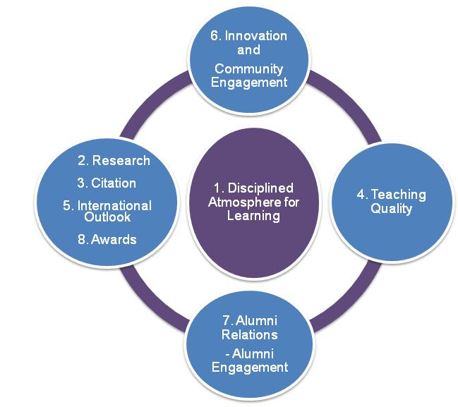
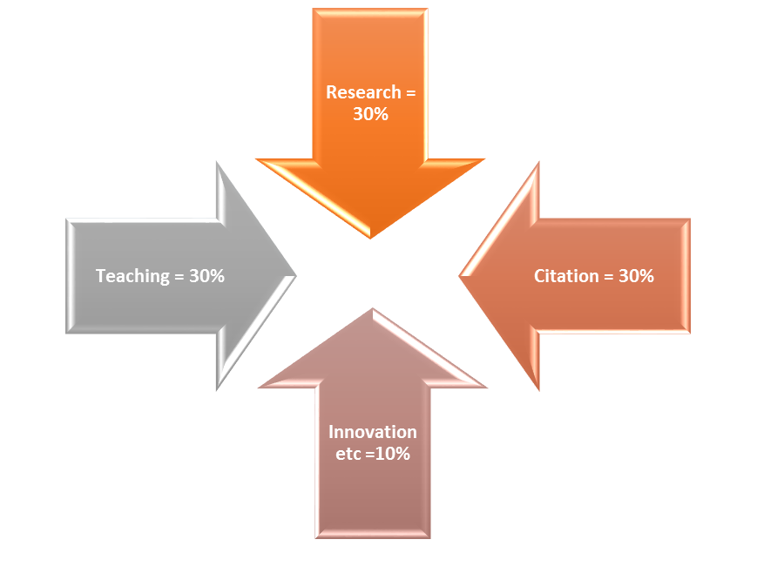
Vision 10:2022 & ReCITE Agenda

Slide 10
CU Strategic Plan: Key features
CU vision, mission & core values
Vision 10:2022
ReCITE agenda
Strategic challenges, priorities & goals
Strategies, actions & Officers responsible for actions
Key performance metrics to measure achievement of goals
Resources required and time lines

Slide 11
Strategic Challenges
Research and innovation
Industry income & Endowment
Governance
Community & International Engagement
Teaching & Learning
High calibre talented Personnel

Slide 12
Strategic Priorities
Enhance national and international reputation for research and innovation by creating and advancing knowledge and improving the quality of life, through the discovery, dissemination, and application of research across all disciplines.
Engage high calibre talented Faculty, Staff and Students by recruiting research-active faculty with record of winning grants, increasing enrolment of postgraduate students and intellectually gifted undergraduate students.

Slide 13
Strategic Priorities (Cont.)
Enhance teaching and learning quality and reputation by providing the opportunity for effective student learning, through outstanding teaching and enriched educational experiences.
Enhance community and international engagement by continually engaging communities to promote economic, social, and cultural well-being and create opportunities for international engagement for faculty, students, staff and alumni, as well as collaborate and communicate globally.

Slide 14
Strategic Priorities (Cont.)
Enhance industry income and develop endowments by encouraging and supporting faculty to compete for external research grants and engage industries, donors and alumni, as valued supporters and advocates who contribute to and benefit from connections to the University.
Enhance good governance and administrative autonomy by encouraging the development of a more effective governance structure and academic freedom in line with international best practices adopted by world class institutions.

Slide 15
Strategic Goals
To provide exceptional, close contact education for both undergraduate and postgraduate students through engagement with highly distinguished faculty based on the University's underlying ethos and unique curriculum.
To cultivate and sustain deep disciplinary scholarship, interdisciplinary and multidisciplinary research initiatives that will position the University for local and global impact.

Slide 16
Strategic Goals (Cont.)
To continuously improve the quality of Covenant University research profile through high quality studies and dissemination in high percentile journals.
To gain local and international reputation as an excellent solution provider to existing and emerging societal challenges through proactive research, entrepreneurship development and international activities.

Slide 17
Strategic Goals (Cont.)
To recruit and retain top-rated faculty and staff, with the view to making Covenant University an institution of excellence and a global brand.
To take advantage of strength and specialization of faculty by creating different career tracks for faculty in research, teaching and a combination of research and teaching.
To attract talented students both nationally and internationally through a fair and rigorous selection process based on scholarly achievement and potential.

Slide 18
Strategic Goals (Cont.)
To deliver quality services and facilities that are effectively managed in order to responsively address the needs of faculty, staff, students, and other stakeholders.
To strive towards financial independence, accountability, and sustainability through improved income generation and efficiency in planning and administration of financial resources.

Slide 19
Strategic Goals (Cont.)
To develop a strong Alumni base and establish a resource for fund raising for the University through external endowments.
To periodically maintain the university assets in order to maximize the ROI from assets.
To maintain a system of governance that enables a disciplined atmosphere for learning, research and community engagement that is consistent with the core values of Covenant University.

Slide 20
Strategic Roles
Teaching & Learning
Research
Community/International Engagement
Human Resources
Admission
Academic and Student Services
Finance
Alumni Relations and Endowments
Facilities and Environment
Governance

Slide 21
Strategies: Teaching & Learning
Sustain the teaching and supervision of all students by senior research-active faculty.
Strengthen the tutorial system for undergraduate education.
Improve interactions and collaborations across the various disciplines at undergraduate and postgraduate levels.
Maintain disciplinary depth and encourage interdisciplinary perspectives
Foster a climate in which teaching is highly valued.

Slide 22
Strategies: Teaching & Learning
Improve the international dimension of our programmes.
Position postgraduate studies at international level, to attract the very best students.
Progressively reduce the staff-student ratio
Initiate academic apprenticeship for postgraduate teaching assistants
Initiate high output part-time and flexible courses for professional practitioners.
Improve the feedback systems from students and relevant professional bodies.

Slide 23
Strategies: Research
Attract and retain highly distinguished academics and researchers.
Provide institutional support to departments and colleges for the realisation of their research agenda.
Provide a conducive and collegial environment in which both senior and junior scholars can thrive.
Deepen research across the various disciplines and encourage interdisciplinary and multidisciplinary research engagements.
Create an atmosphere for focused research pursuits.

Slide 24
Strategies: Research
Enhance administrative and support services to facilitate research excellence and knowledge transfer.
Encourage and support international research and collaborations.
Motivate faculty to publish in journals and conference proceedings that are indexed in SCOPUS and the Thomson Reuters Web of Science, and aim at high citations.
Ensure that research is conducted without compromising applicable ethical standards.
Engage Research Track faculty.

Slide 25
Strategies: Research
Increase number of faculty attracting international grants.
Create research accounts for faculty to boost research output.
Equip the laboratories across the departments with standard state-of-the-art research facilities.
Ensure proper maintenance of research equipment across the departments
Establish standard laboratory conditions for research.

Slide 26
Strategic Actions: Research

Slide 27
Performance metrics: Research
Ratio of SCOPUS indexed publications per staff member
Increase in Number and quality of publications in top-ranked channels (75th percentile and above)
Increase in Percentage of research-active faculty. The target is that 60 per cent of Covenant University faculty will become research active in the next 5 years.
Increase in number of competitive peer-reviewed external grant research awards per year
Increase in research-derived products

Slide 28
Performance metrics: Research
Increase in the percent of faculty who are Principal Investigators (PIs) on external grants; total sponsored research per Full Time Equivalent -FTE faculty; number of proposals submitted/successful.
Quality of placement for PhD graduates ie quality of post-training employment status of doctoral graduates.
Assessment of researchers’ satisfaction with intellectual and copyright policy using survey instruments.

Slide 29
Performance metrics: Research
Community impact assessment of our research
Increase in patronage by Researchers from other Universities and Research Institutes.
Increase in IGR as a result of patronage by Researchers from other institutions.
Improvement in the availability/functionality of research equipment.
Return on investments and/or value addition is projected to be achieved within 10 years for all acquired equipment.

Slide 30
Performance metrics: Alumni Relations & Endowments
Increase in the Percentage of graduates who are active members of the alumni association.
Increase in Percentage of alumni employed annually by the University.
Increase in the Number of contracts awarded to alumni by the University annually.
Increase in Amount of cash donations and other gifts received from alumni annually.
Increase in Number of endowments, scholarships and fellowships instituted by the alumni in the University.

Slide 31
Performance metrics: Alumni Relations & Endowments (cont.)
Increase in Number of developmental projects executed by the alumni within the University.
Increase in Number of volunteering and mentoring programmes organized by the alumni within the University.
Increase in financial donations and other gifts received from partners annually.
Increase in Number of endowments, scholarships and fellowships instituted by partners of the University.
Increase in Number of developmental projects executed by partners of the University.

Slide 32
Key Resources
Funding for various actions contained in the strategies.
Effective and efficient Teaching and Non-Teaching personnel.
Highly talented undergraduate and postgraduate students
Infrastructure including buildings, laboratory equipment, Chemicals, Reagents, Consumables, Teaching resources.

Slide 33
Resources, Officers &Timeline
Strategy | Actions | Resources needed | Person/Office Responsible | Timeline
Teaching and Learning
1 | i | Personnel (teaching and research); Funding (teaching aids and research equipment) | VC; Registrar; HODs | 2018-2028
 | ii | Personnel (Administrative) | HODs
 | iii | Personnel (teaching and research) | HODs; All Faculty | 2018- 2028
 | iv | Personnel (professional teachers and trainers); Funding (building, training, etc.) | VC; Registrar; DPPD | 2018- 2028
 | v | Personnel (Administrative) | DQAS; DAPU | 2018- 2028
 | vi | Funding (scholarship) | Dean, SPS; HODs | 2018- 2028
 | vii | Personnel (Administrative, teaching); | Registrar; Dean, SPS; HODs | 2018- 2028

Slide 34
Recommendations
Encourage faculty to focus on only SCOPUS-indexed publications in high percentile range with a target of 1000 publications per year beginning from 2018.
Encourage faculty to generate SCOPUS-listed patents for their inventions and innovations.
Encourage faculty to compete and attract international grants for research.
Recruit high calibre researchers both locally and internationally with track records of winning external research grants.

Slide 35
Recommendations (cont.)
Create three (3) career tracks for faculty including Research, Research/Teaching and Teaching to harness their peculiar strengths and boost research and teaching quality.
Exceptional faculty with track record of research productivity should be encouraged to pioneer the Research track which shall have an increment in their pay structure.
Regularly upgrade laboratories and related infrastructure to international standards.
Create research accounts for all faculty based on research productivity to boost research-related activities and reputation.

Slide 36
Recommendations (cont.)
Continue to encourage staff to go on research leave including postdoctoral fellowships; sabbatical and visiting fellowships with pay so as to achieve the goals on research, international profile, reputation and collaboration. Such faculty may be mandated to produce at least three (3) SCOPUS-indexed publications per annum for the period of the leave.
Establish a grants management office and engage trained personnel who are experienced in managing and packaging grant applications to provide training, information and support for faculty.

Slide 37
Recommendations (cont.)
Create research accounts for all faculty based on research productivity to boost research
Increase postgraduate students’ admission and to increase research productivity.
Establish a foundation with a board of trustees and engage professional personnel to identify potential partners and donors to supporting research.
Standardize career tracks for non-teaching staff; and develop standard promotion criteria for them
Establish a strategic planning and implementation office and engage professional personnel trained in strategic management to revise, update and monitor implementation the strategic plan.

Slide 38
Conclusion & Appreciation
Document is a roadmap that will help guide our activities as a University to achieve our set goals
It’s a dynamic document that can accommodate fresh ideas
Every stakeholder including management, faculty, staff and students are encourage to embrace the document
I appreciate the management team led by the Vice Chancellor for their critical inputs
I appreciate all the committee members (past & present) and working groups for their efforts in generating this document

Slide 39
Ndewo!
Q/A

