Slide 1


THE SDG IMPACT RANKINGS:
MATTERS ARISING
&
STRATEGIES FOR IMPROVED PERFORMANCE
AAA. Atayero, PhD

Slide 2
Agenda
THE Inaugural SDG Impact Rankings (IR) 2019
Impact Rankings Methodology
THE IR 2020:
  Analysis of Covenant’s Performance &
  Identification of Gaps
Strategies for Improved Performance
Concluding Recommendations

Slide 3
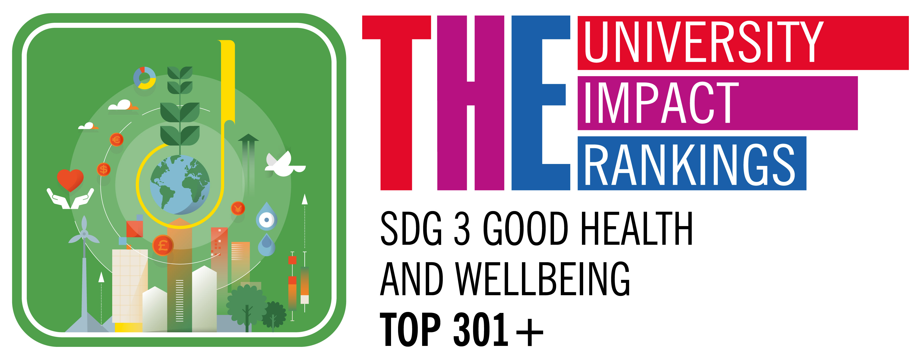
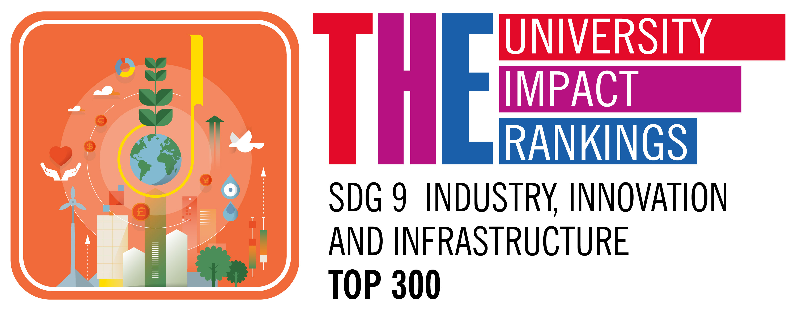

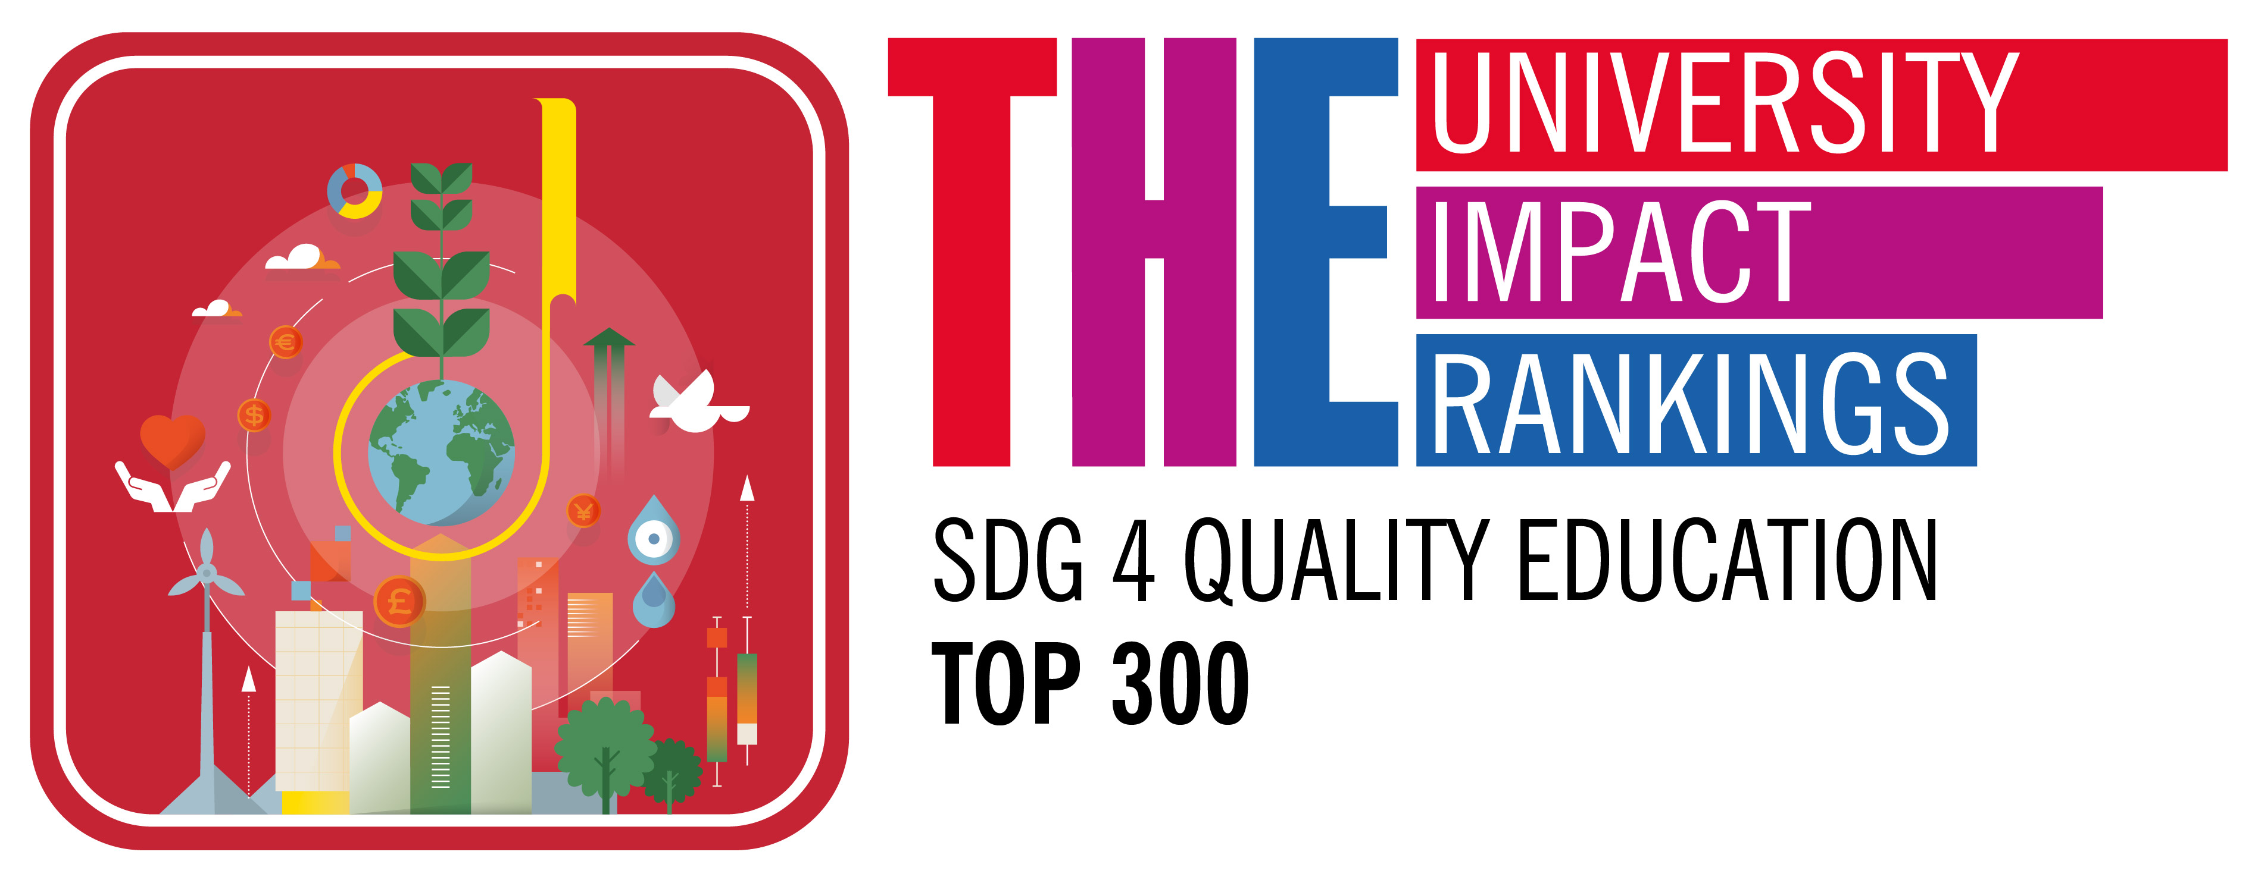
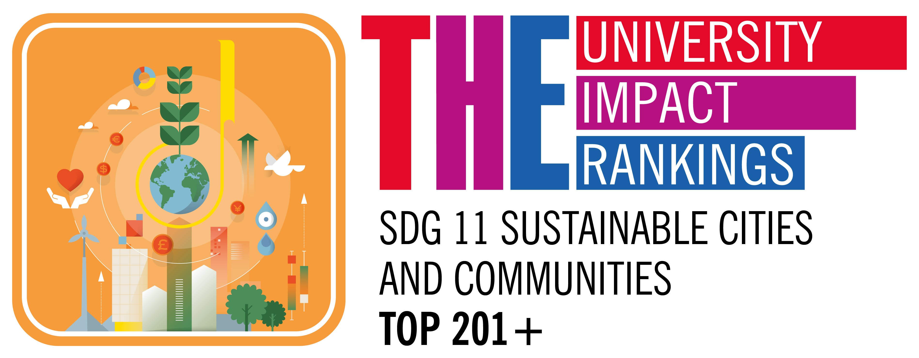
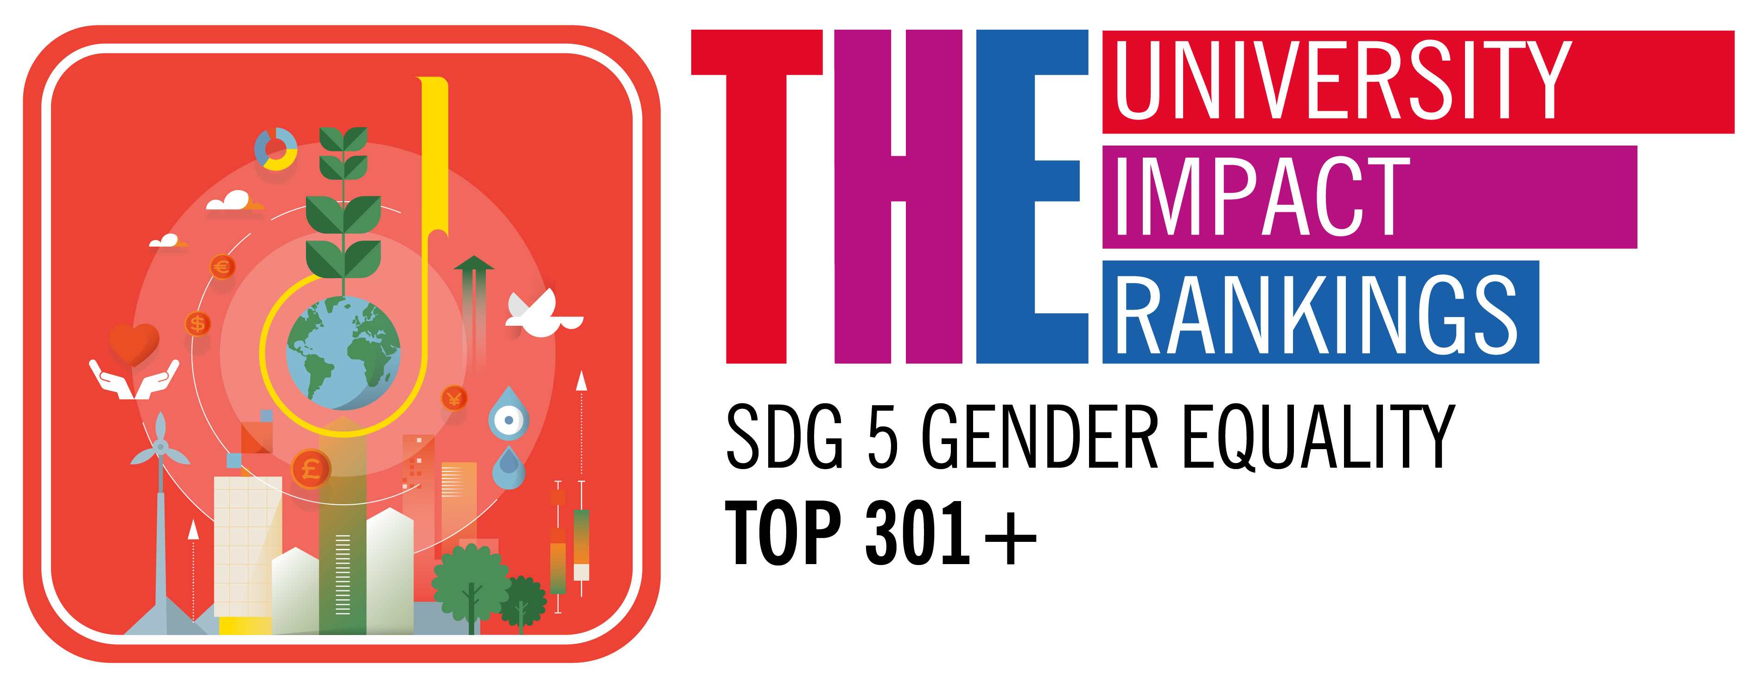
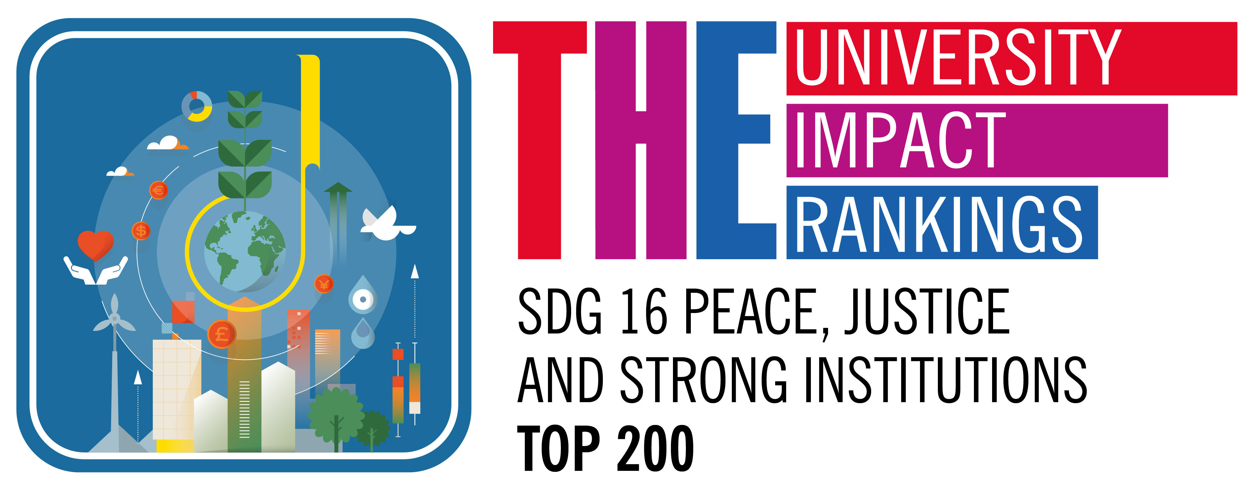

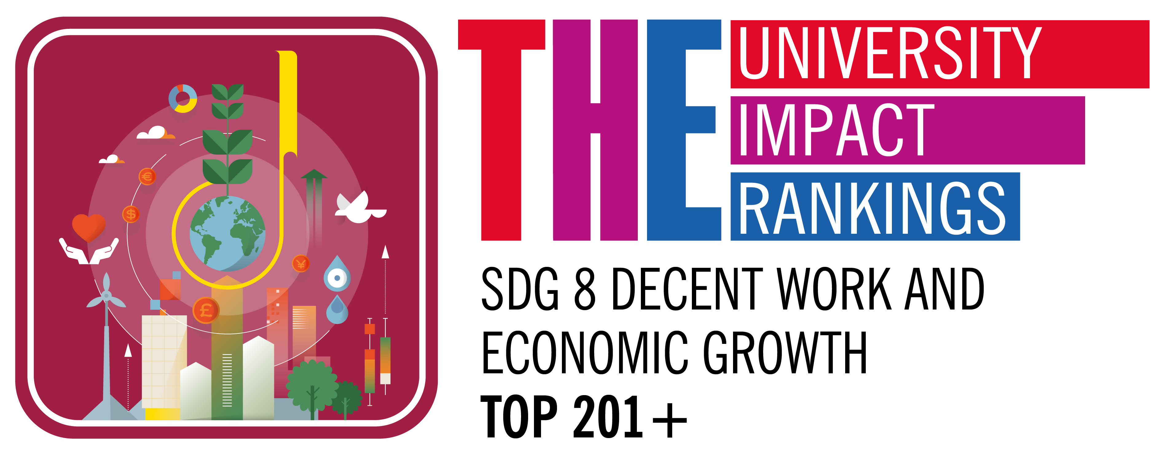
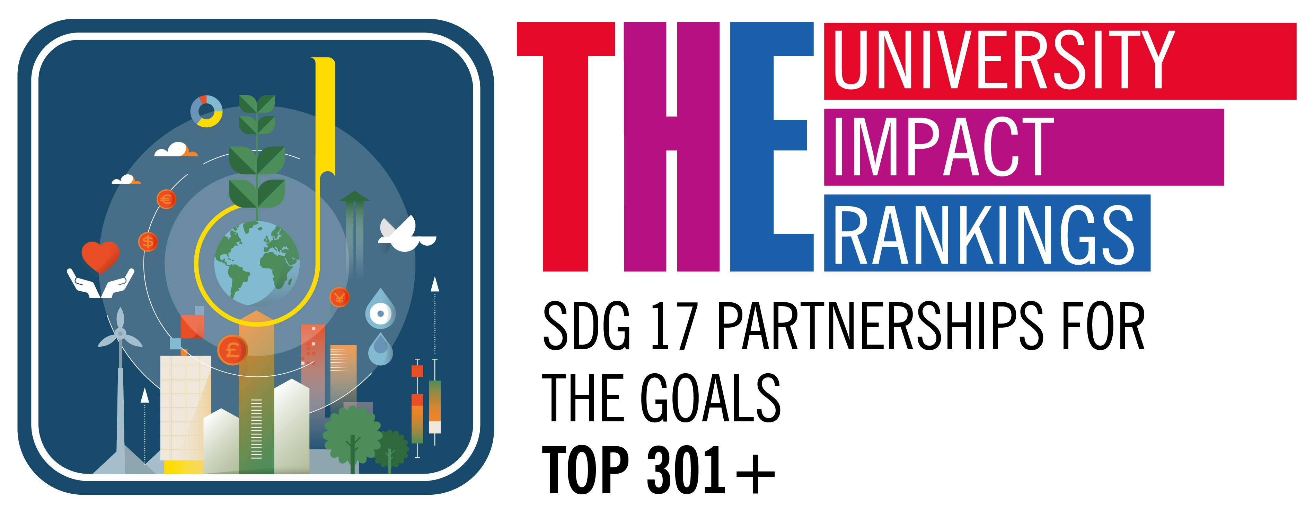

Slide 4
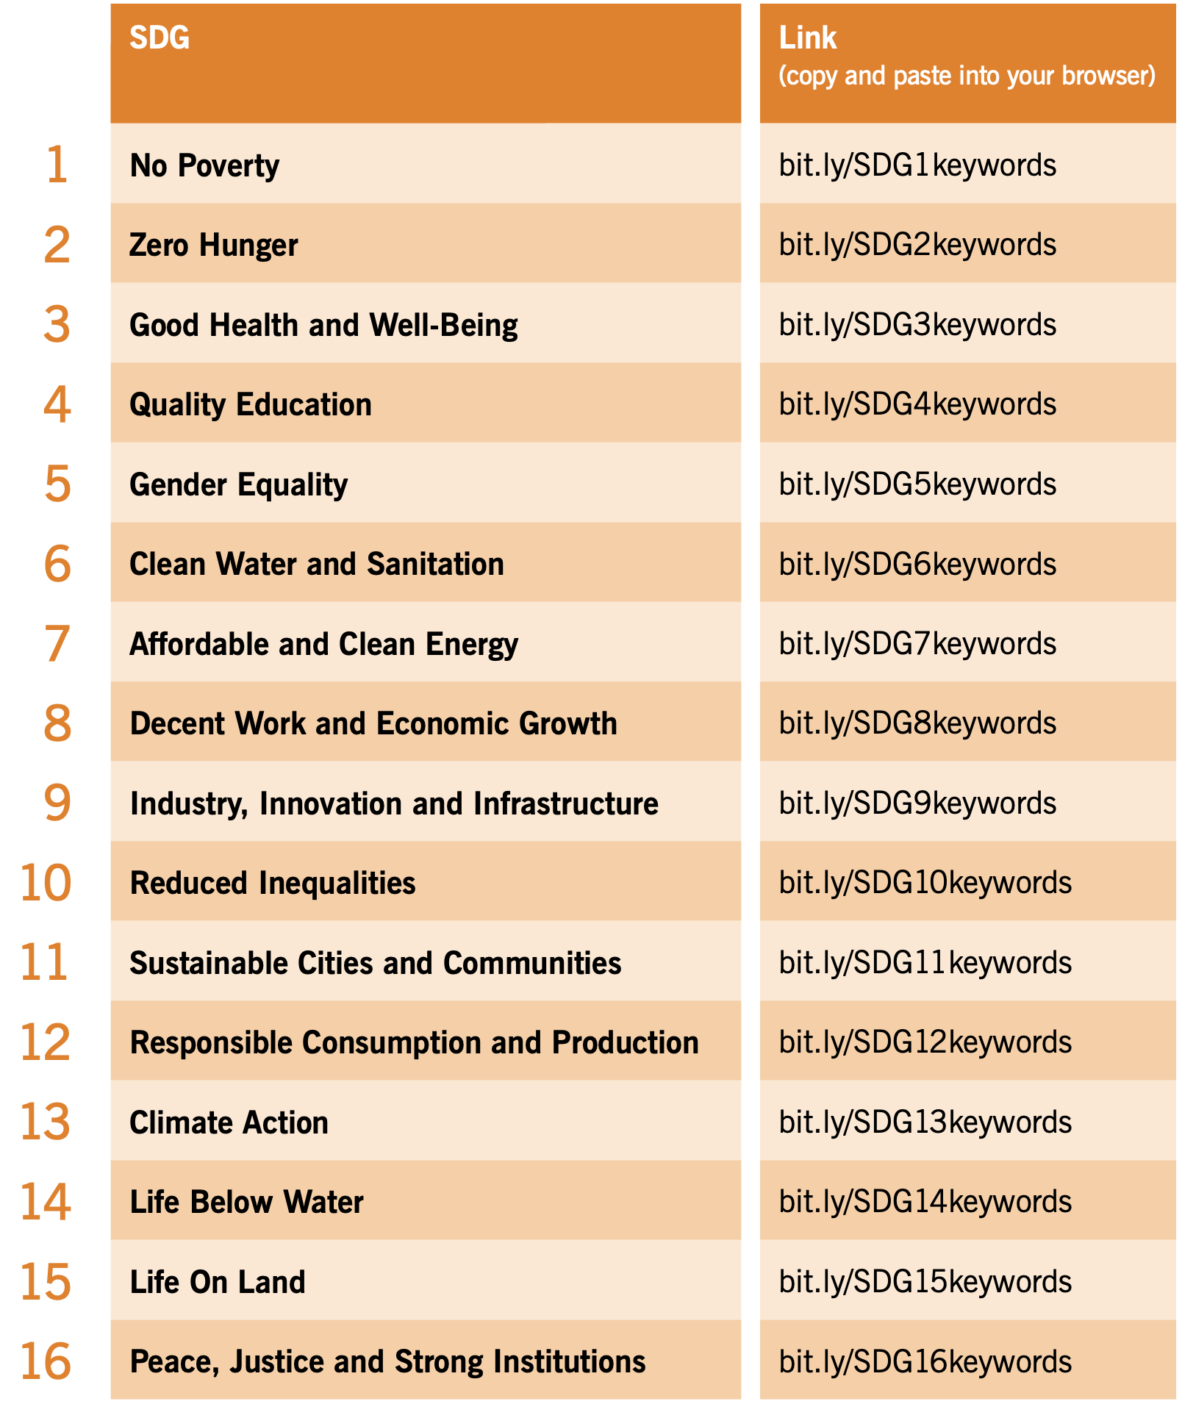
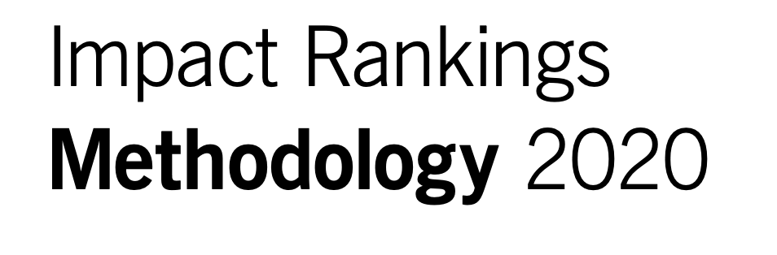
RESEARCH
All research metrics are measured against a keyword search of the Scopus dataset.
Only documents that are directly related to the SDG are evaluated.
The current keyword search terms for each SDG can be accessed from the following links:

Slide 5
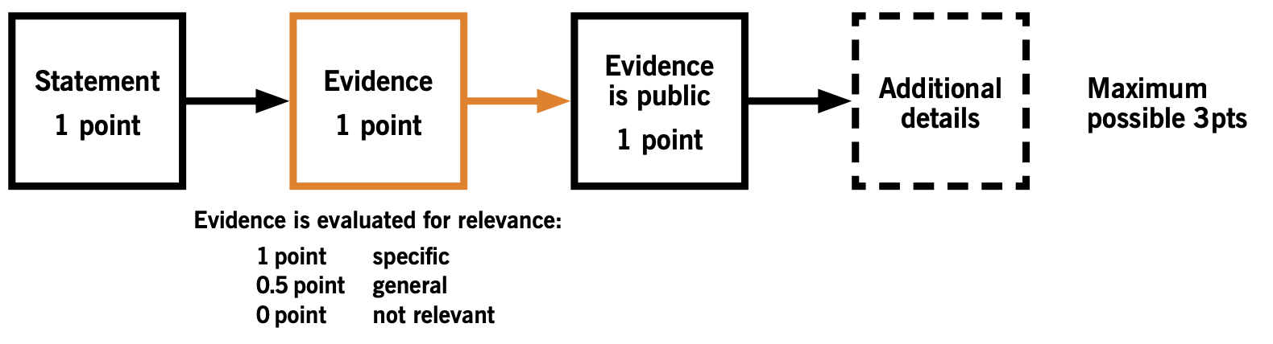
EVIDENCE

Slide 6
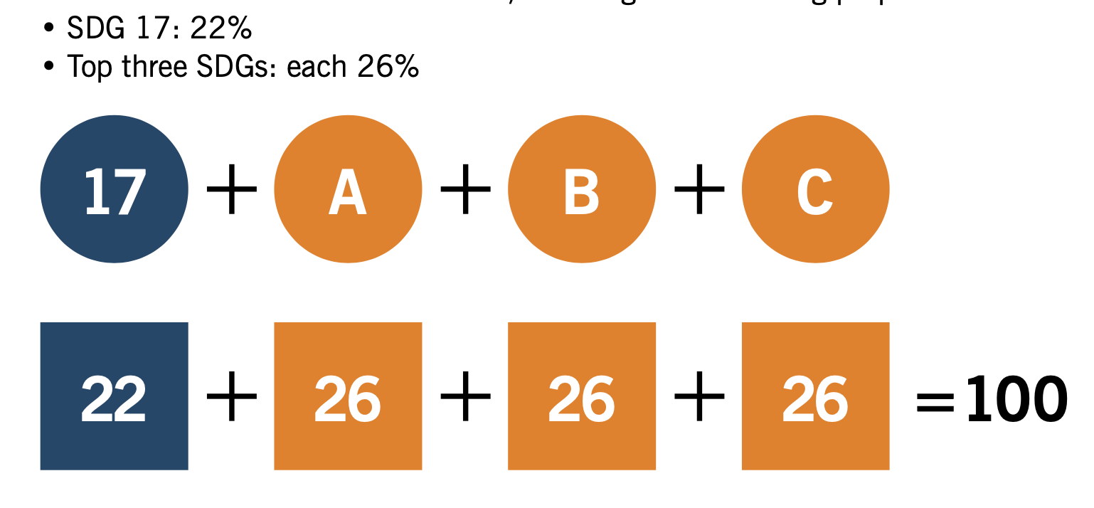
CALCULATING OVERALL SCORE

Slide 7

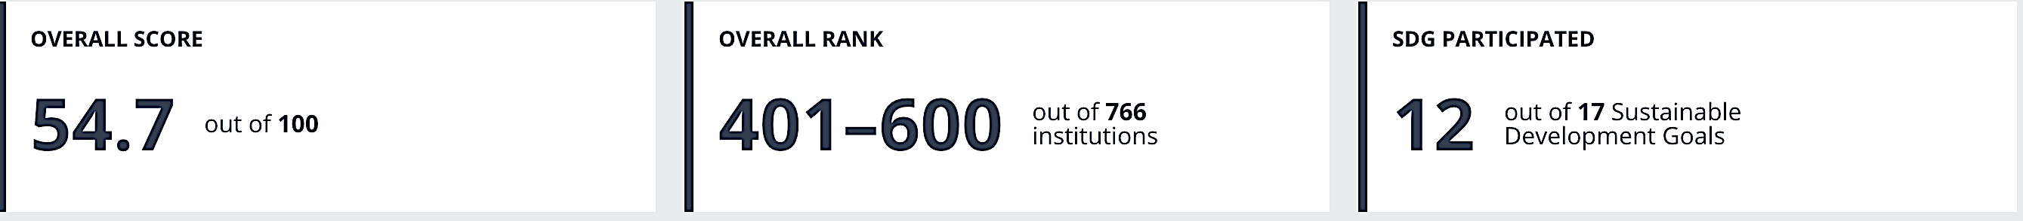
Covenant’s Performance: Overall

Slide 8
Identified Ranking Gaps
Worldwide SDG scores: THE IR 2020 Data
 | SDG 1 | SDG 2 | SDG 2 | SDG 3 | SDG 3 | SDG 4 | SDG 4 | SDG 5 | SDG 5 | SDG 6 | SDG 6 | SDG 7 | SDG 7 | SDG 8 | SDG 8 | SDG 9 | SDG 9 | SDG 10 | SDG 10 | SDG 11 | SDG 11 | SDG 12 | SDG 13 | SDG 13 | SDG 14 | SDG 14 | SDG 15 | SDG 15 | SDG 16 | SDG 17 | SDG 17
Top | 88.5 | 94.9 | 94.9 | 90.8 | 90.8 | 95.0 | 95.0 | 83.2 | 83.2 | 81.4 | 81.4 | 83.2 | 83.2 | 83.8 | 83.8 | 100.0 | 100.0 | 91.8 | 91.8 | 94.8 | 94.8 | 92.3 | 84.8 | 84.8 | 97.7 | 97.7 | 95.7 | 95.7 | 90.6 | 99.2 | 99.2
75% | 60.6 | 63.8 | 63.8 | 70.2 | 70.2 | 60.6 | 60.6 | 58.5 | 58.5 | 54.1 | 54.1 | 63.3 | 63.3 | 62.9 | 62.9 | 69.5 | 69.5 | 59.7 | 59.7 | 68.6 | 68.6 | 66.0 | 52.1 | 52.1 | 65.9 | 65.9 | 66.4 | 66.4 | 71.1 | 70.5 | 70.5
Median | 46.6 | 49.6 | 49.6 | 57.5 | 57.5 | 45.8 | 45.8 | 43.5 | 43.5 | 43.7 | 43.7 | 50.7 | 50.7 | 51.9 | 51.9 | 46.4 | 46.4 | 45.8 | 45.8 | 53.8 | 53.8 | 51.2 | 40.0 | 40.0 | 48.5 | 48.5 | 46.6 | 46.6 | 60.5 | 54.2 | 54.2
25% | 33.9 | 31.4 | 31.4 | 40.8 | 40.8 | 32.4 | 32.4 | 31.8 | 31.8 | 32.5 | 32.5 | 36.3 | 36.3 | 39.9 | 39.9 | 27.1 | 27.1 | 33.5 | 33.5 | 40.2 | 40.2 | 34.4 | 26.0 | 26.0 | 29.1 | 29.1 | 30.5 | 30.5 | 46.1 | 37.4 | 37.4
Bottom | 5.4 | 1.1 | 1.1 | 2.6 | 2.6 | 2.9 | 2.9 | 3.2 | 3.2 | 1.0 | 1.0 | 0.4 | 0.4 | 6.3 | 6.3 | 2.2 | 2.2 | 6.7 | 6.7 | 9.0 | 9.0 | 0.7 | 0.4 | 0.4 | 0.9 | 0.9 | 0.9 | 0.9 | 11.6 | 4.1 | 4.1
Covenant SDG Scores 2020
 | 46.4 |  | 37.8 |  | 36.3 |  | 49.0 |  | 34.7 |  | 45.8 |  | 26.8 |  | 44.3 |  | 21.1 |  | - |  | - | 29.8 | 13.6 |  | - |  | - |  | - |  | 65.5
Gap | 42.1 |  | 57.1 |  | 54.5 |  | 46.0 |  | 48.5 |  | 35.6 |  | 56.4 |  | 39.5 |  | 78.9 |  | 0 |  | 0 | 62.5 | 71.2 |  | 0 |  | 0 |  | 0 |  | 33.7

Slide 9
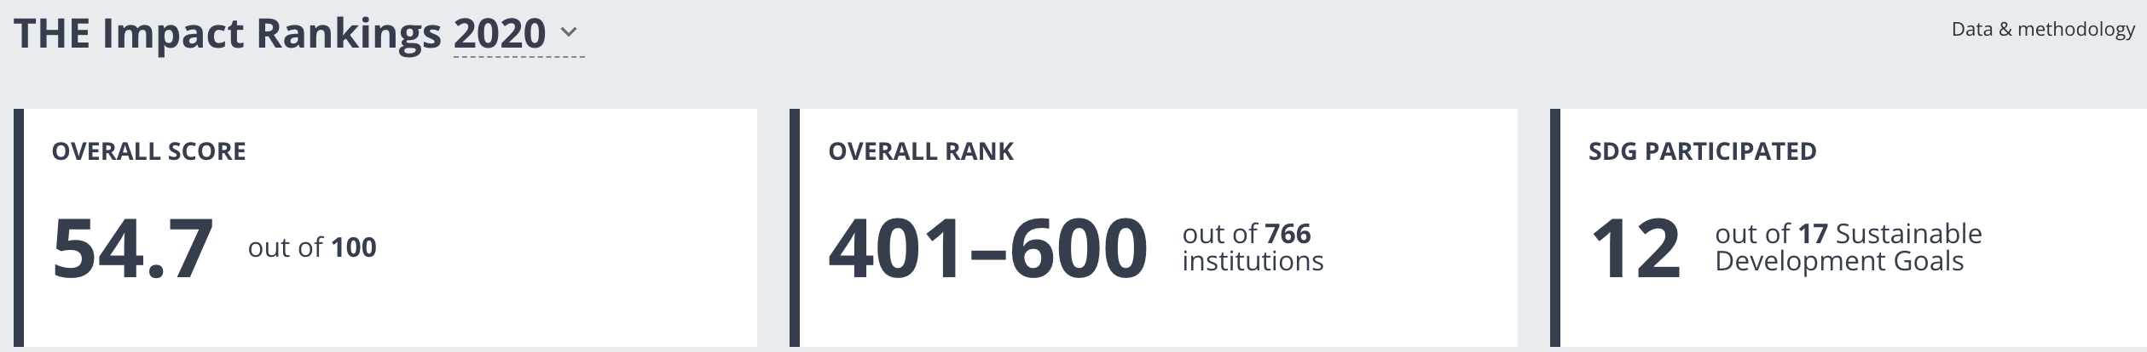
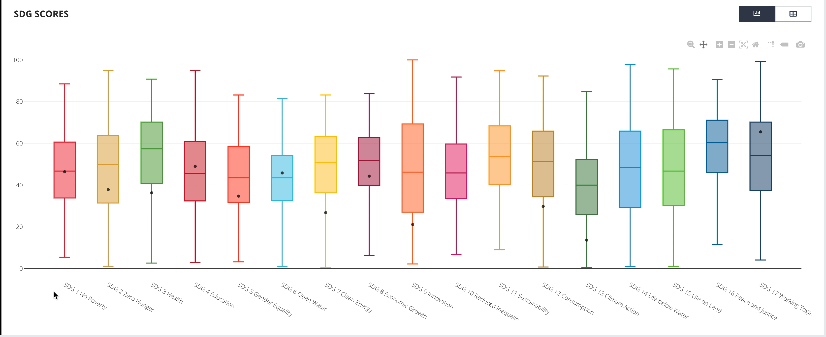
Covenant’s Performance: By SDGs

Slide 10
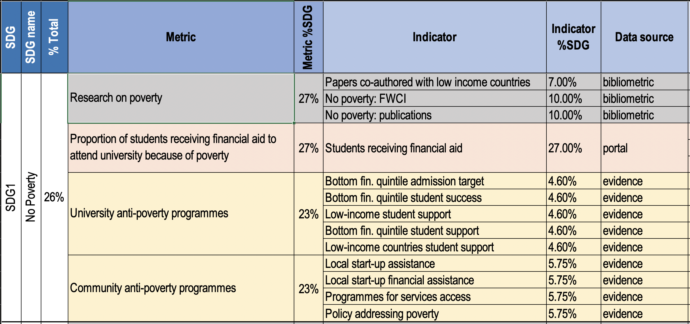
SDG1: Scoring Methodology

Slide 11
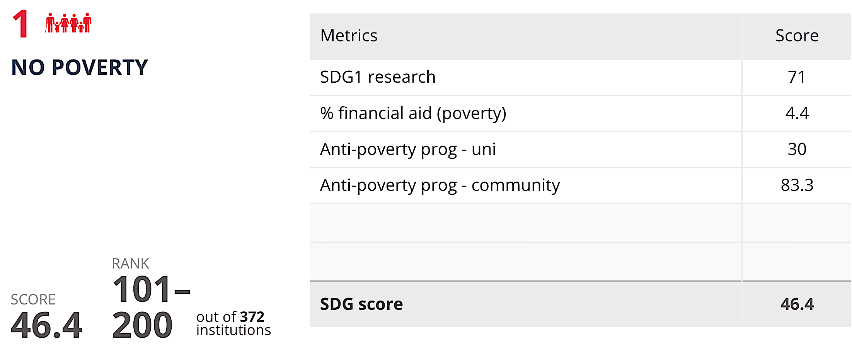
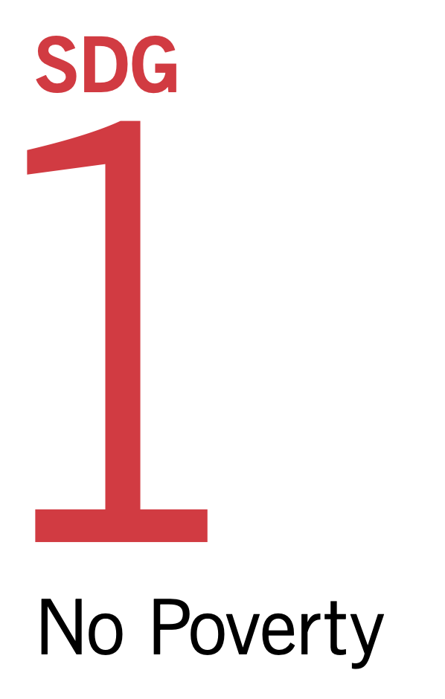
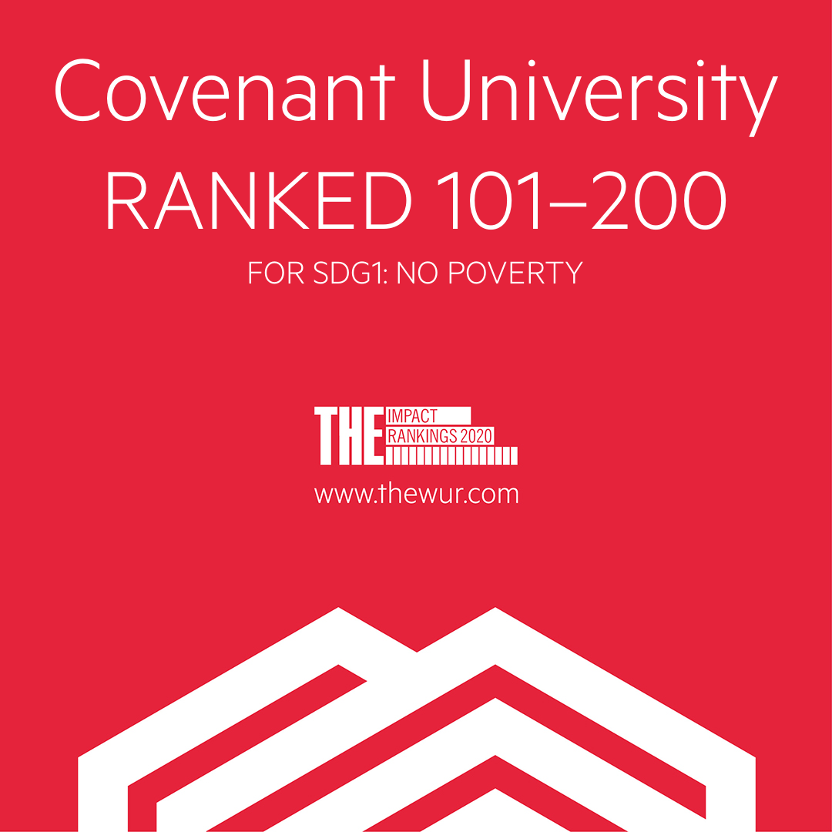
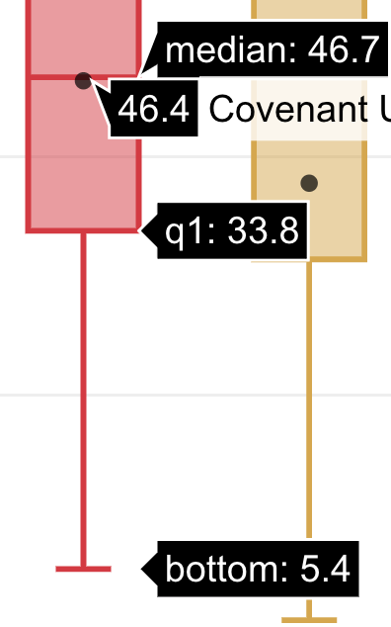
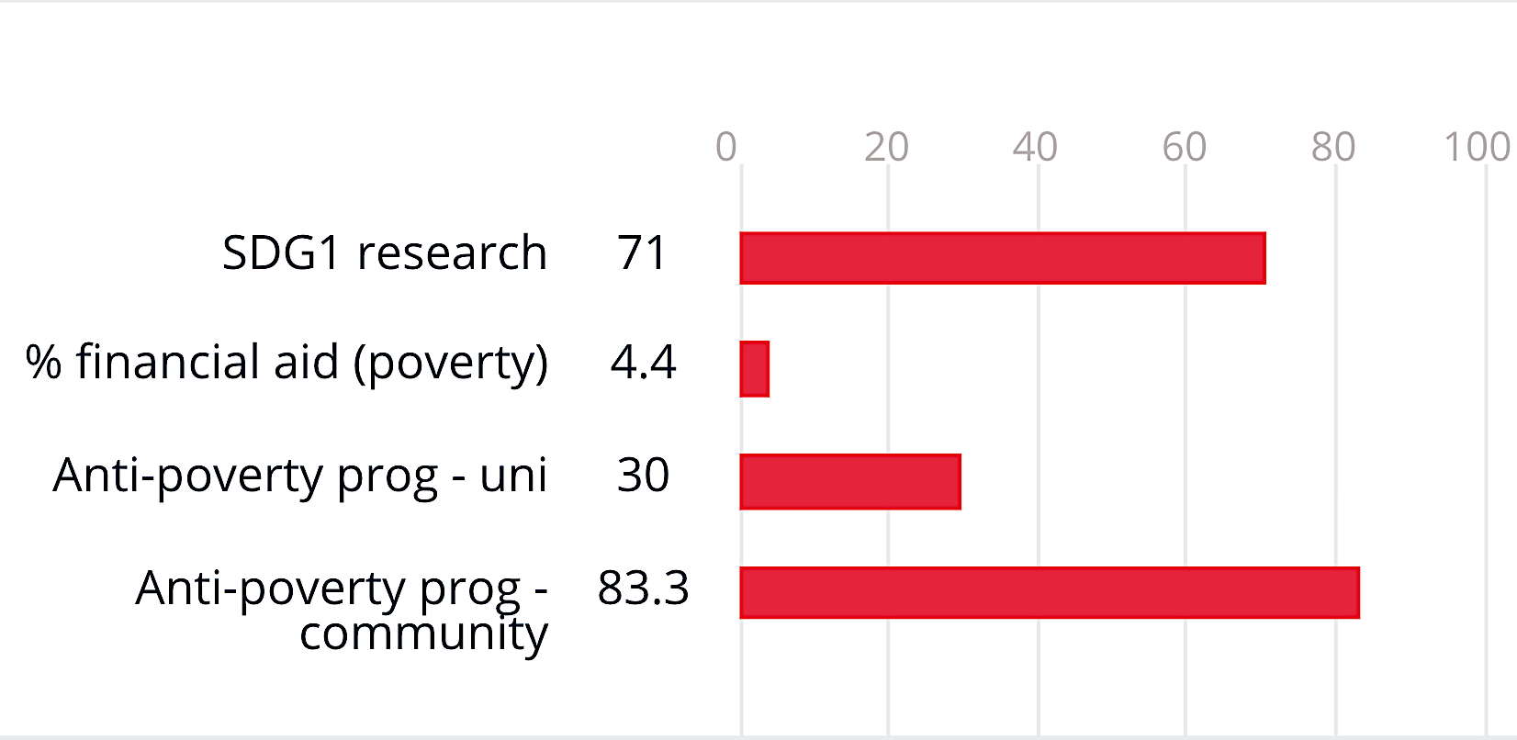

Slide 12
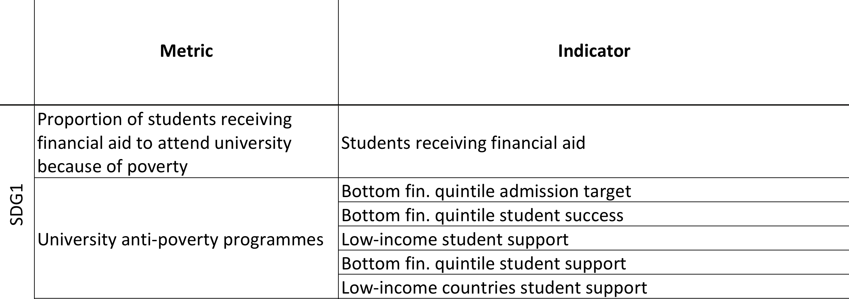
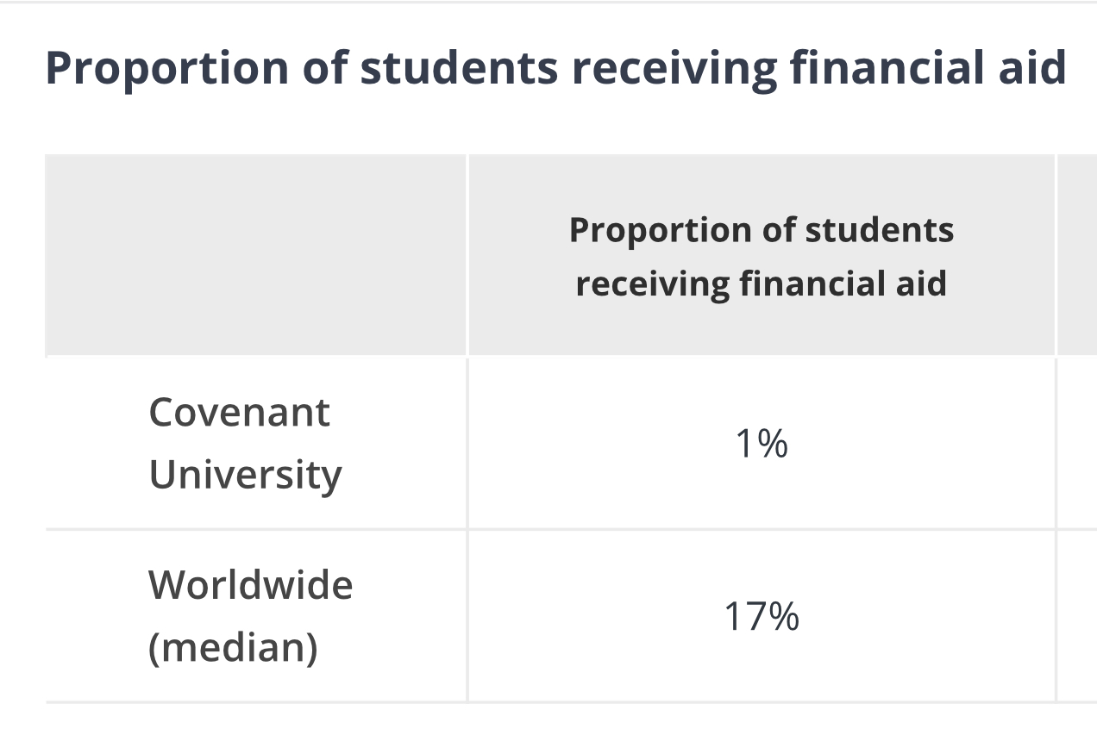
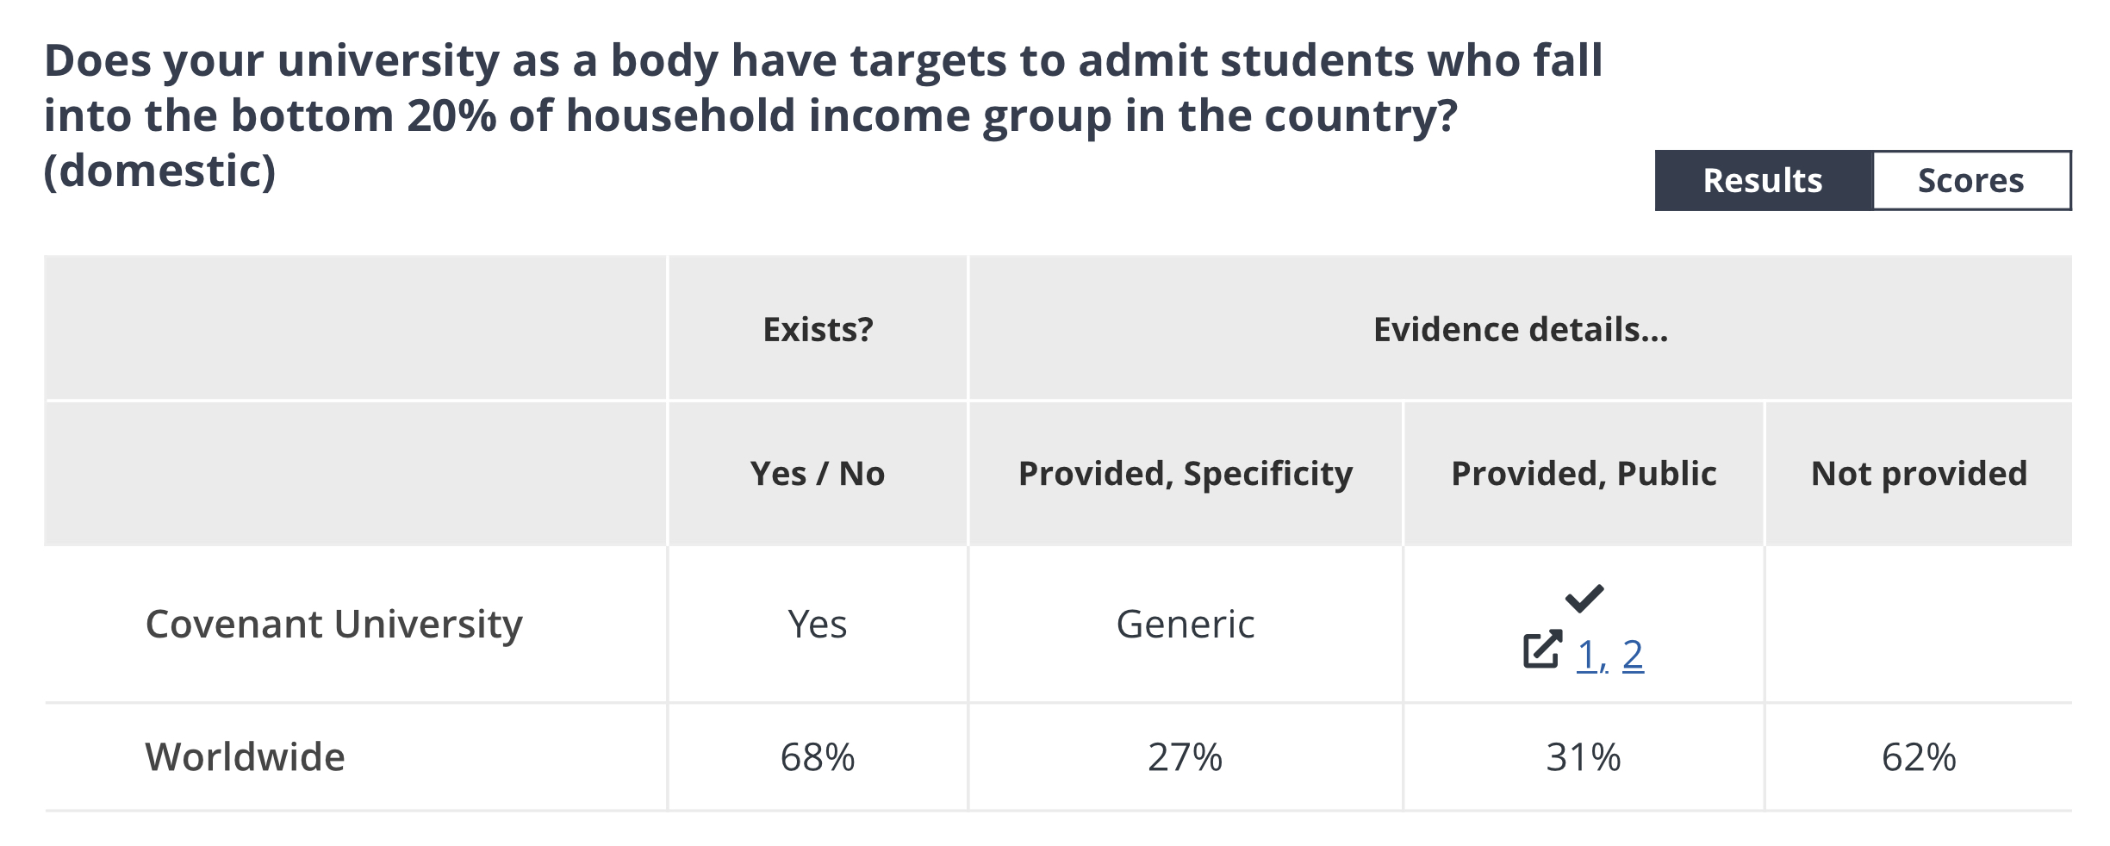

Slide 13
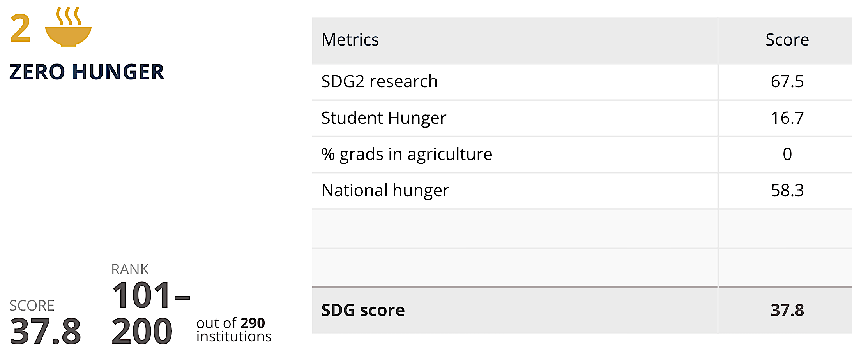

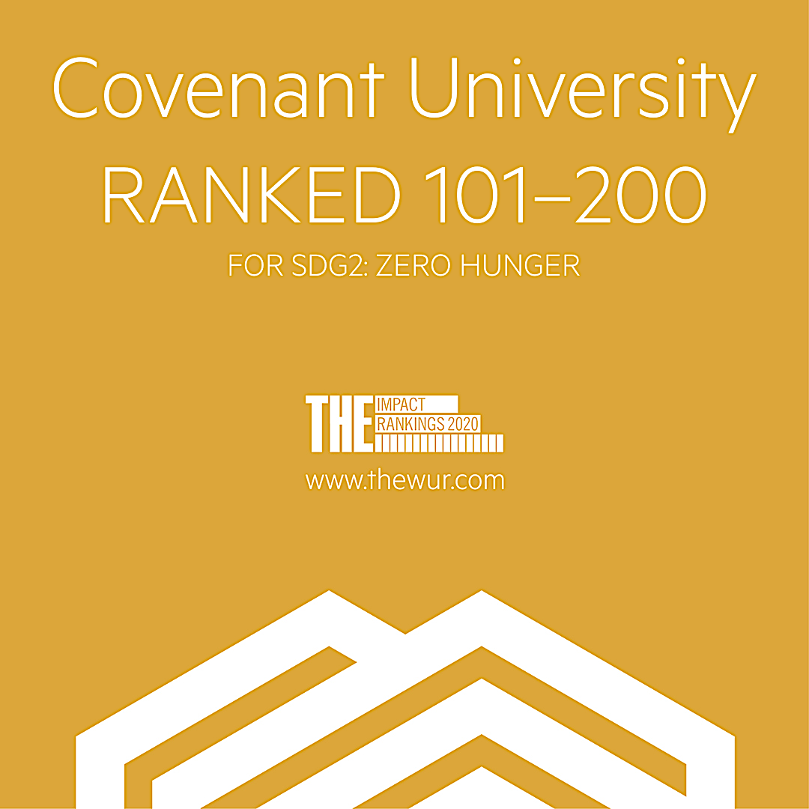
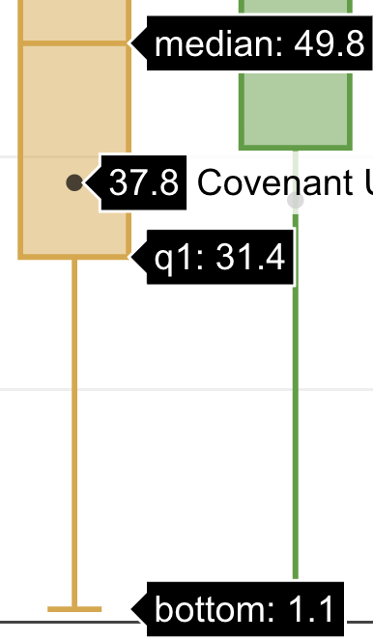
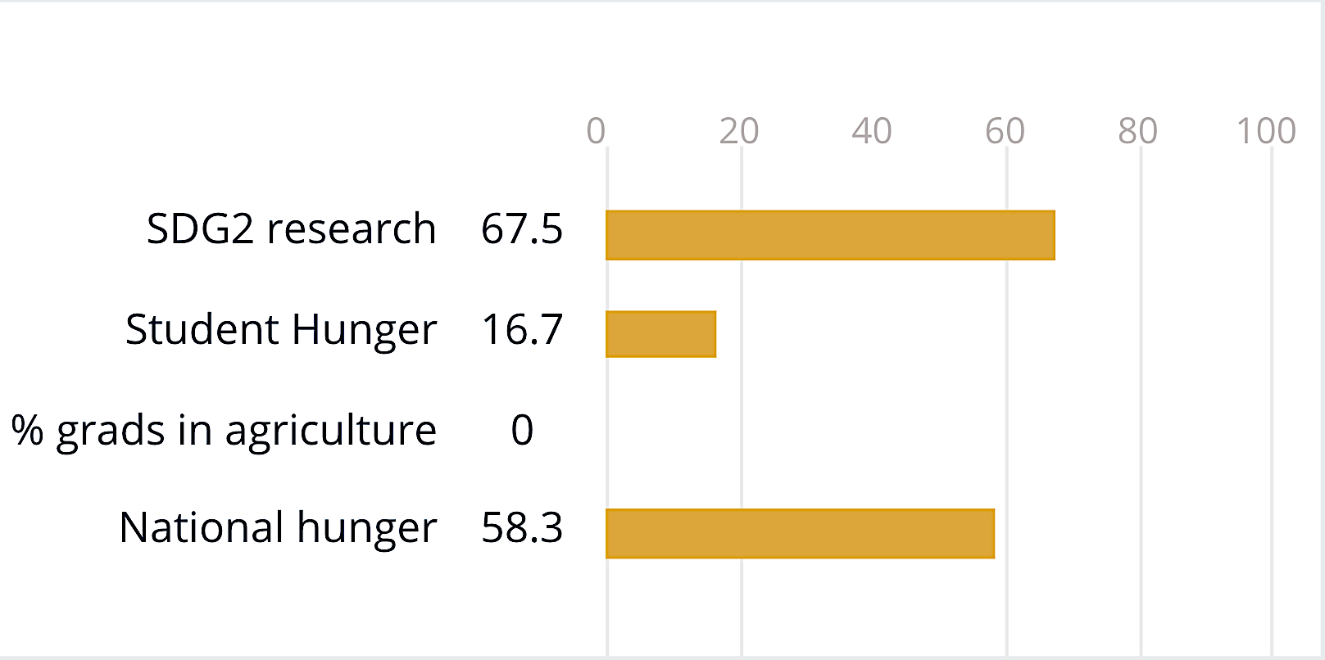

Slide 14
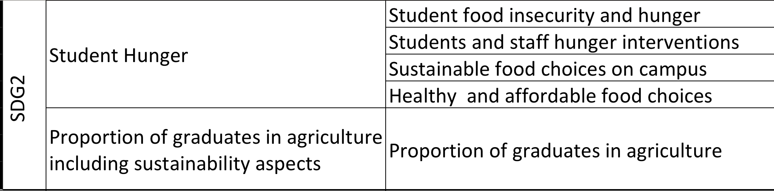
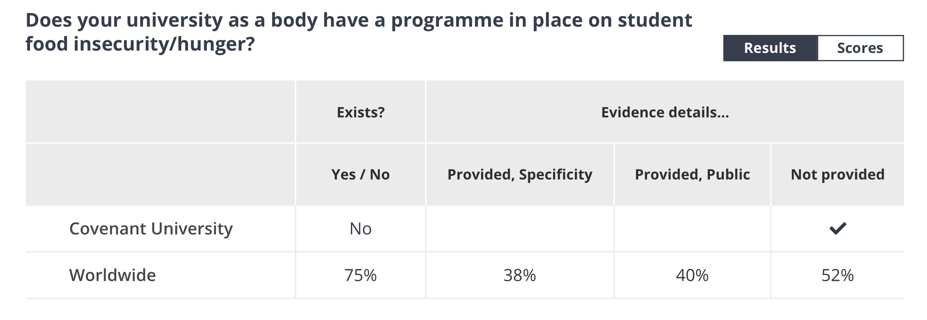
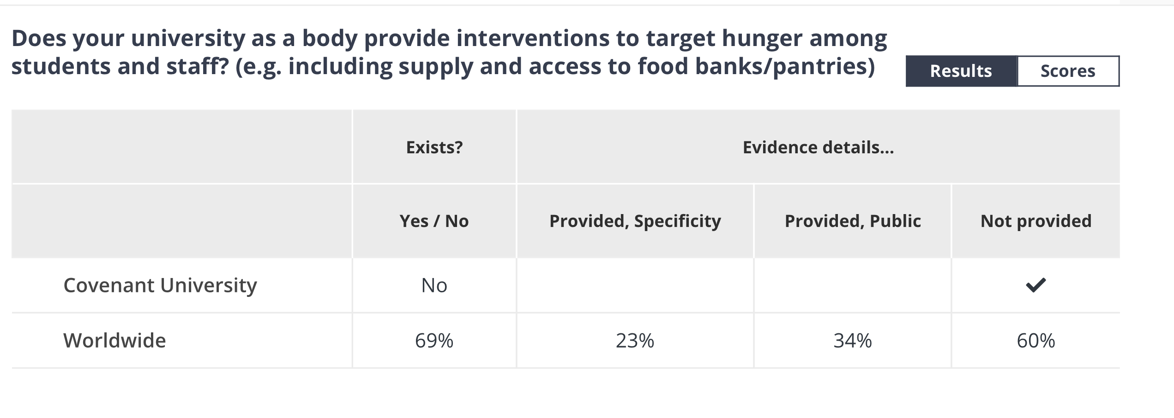

Slide 15
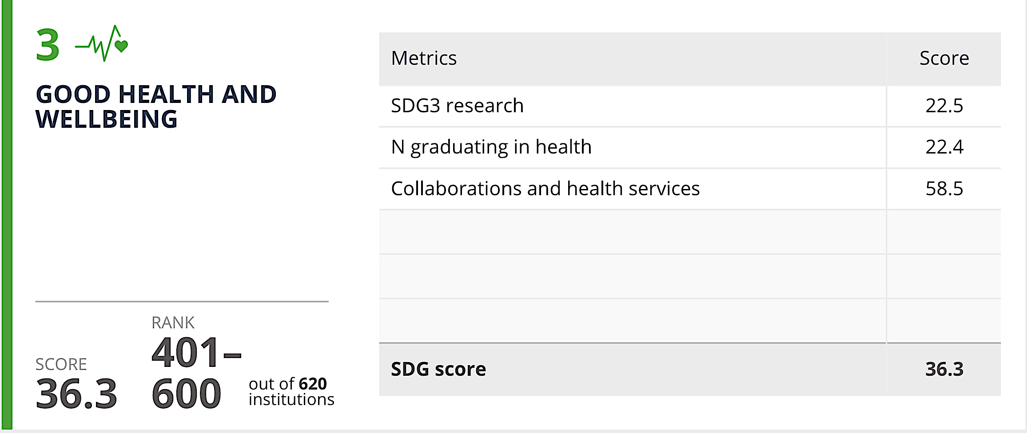
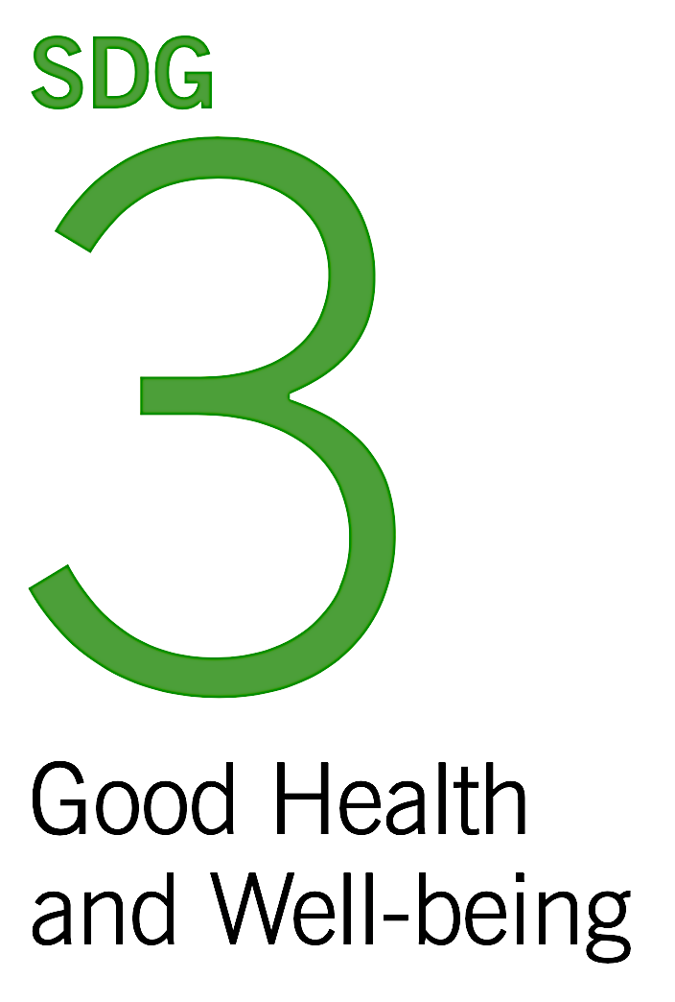
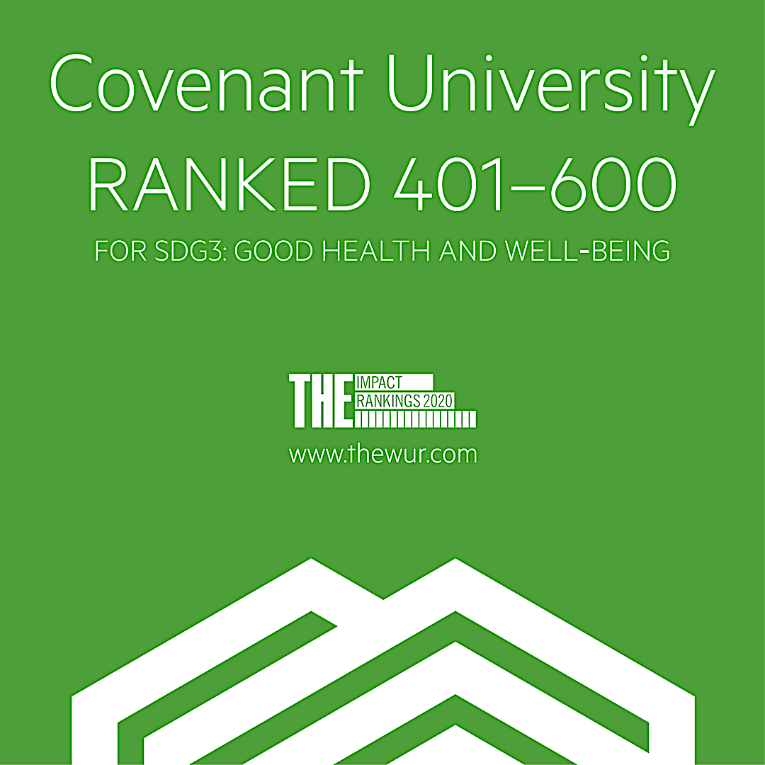
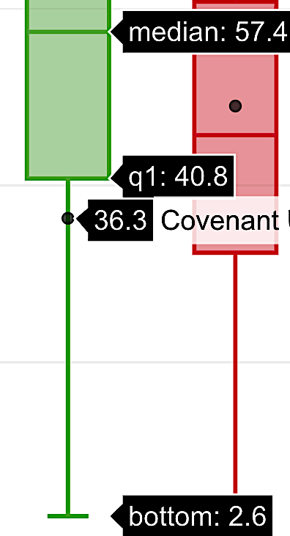
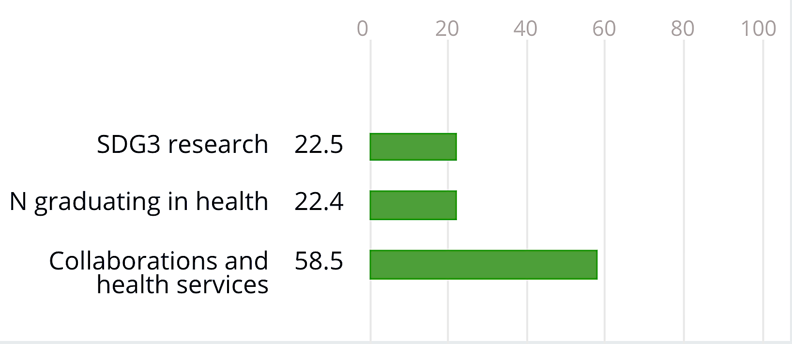

Slide 16
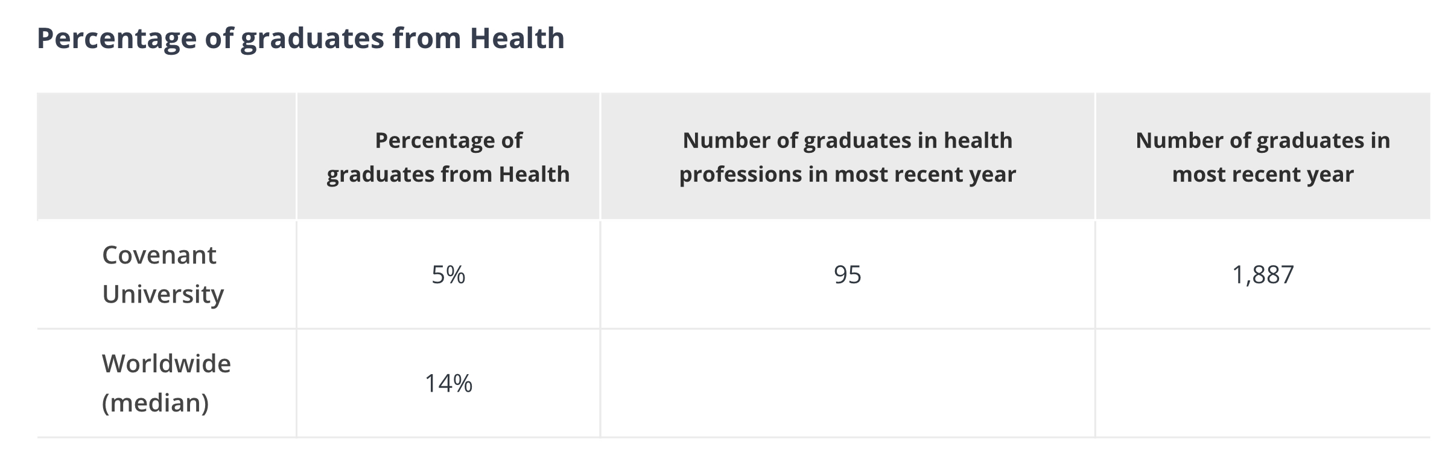
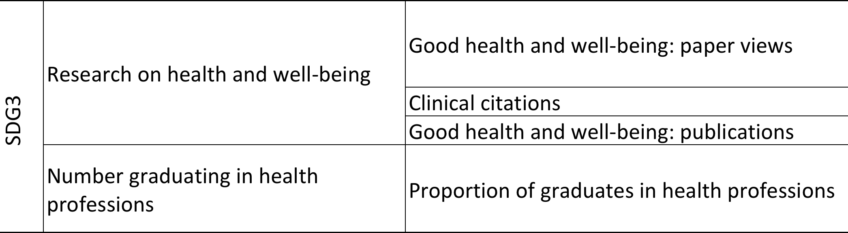
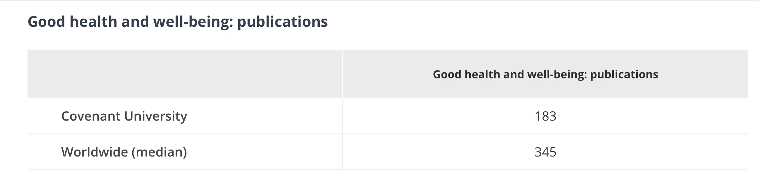
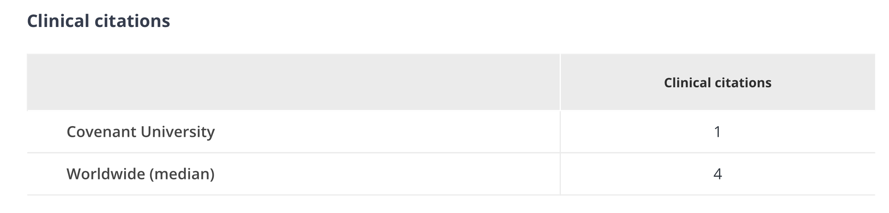

Slide 17
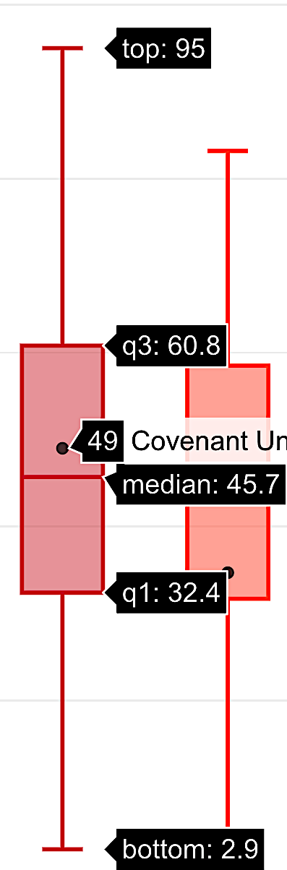

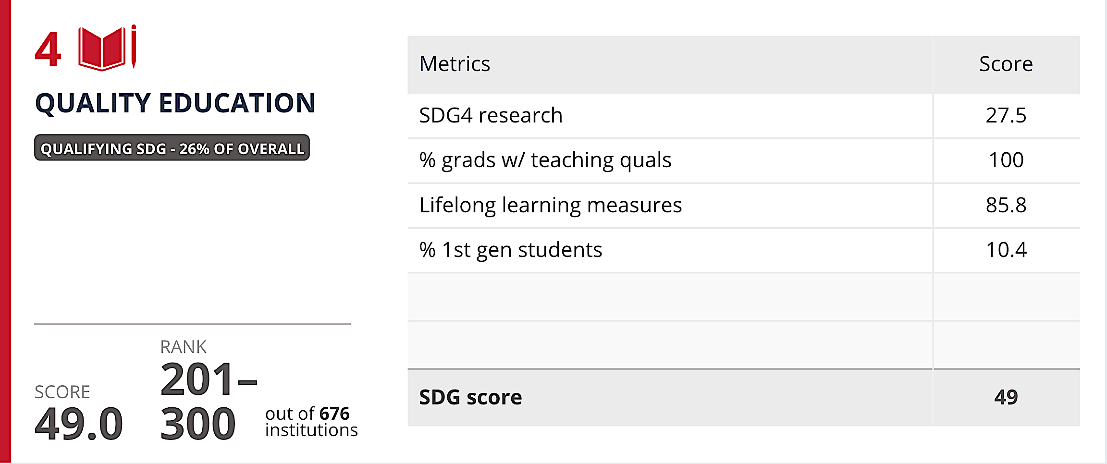
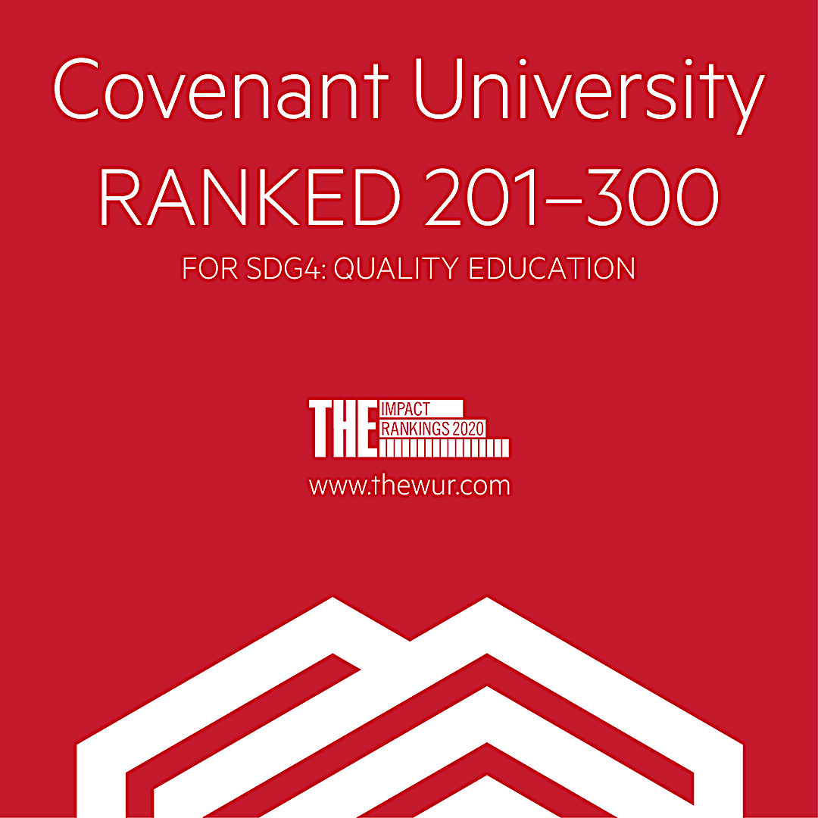
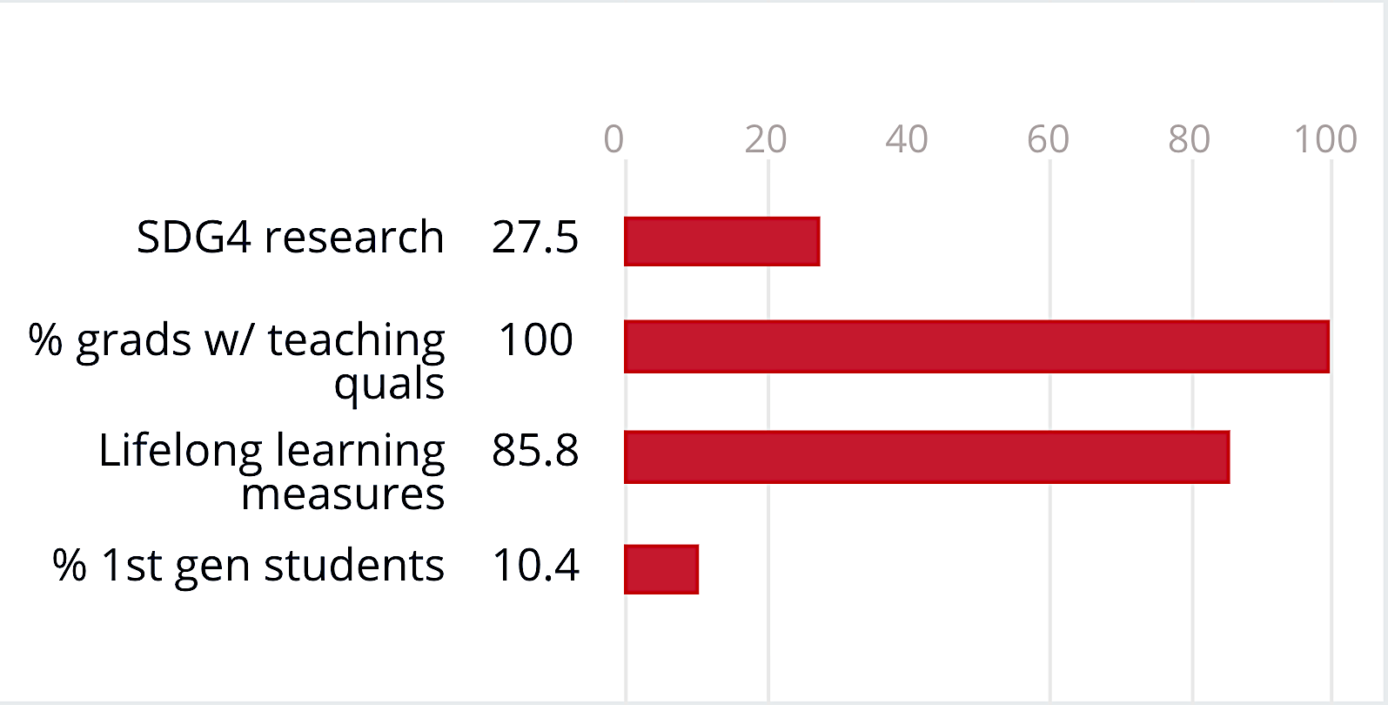

Slide 18
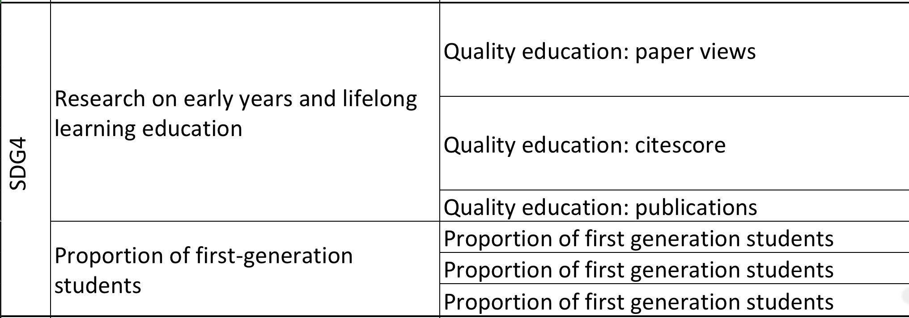
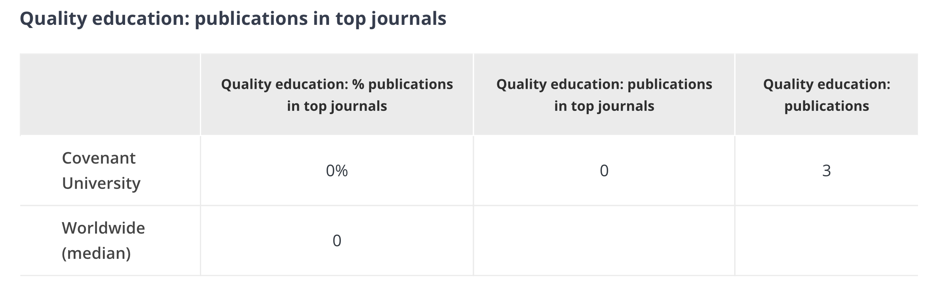
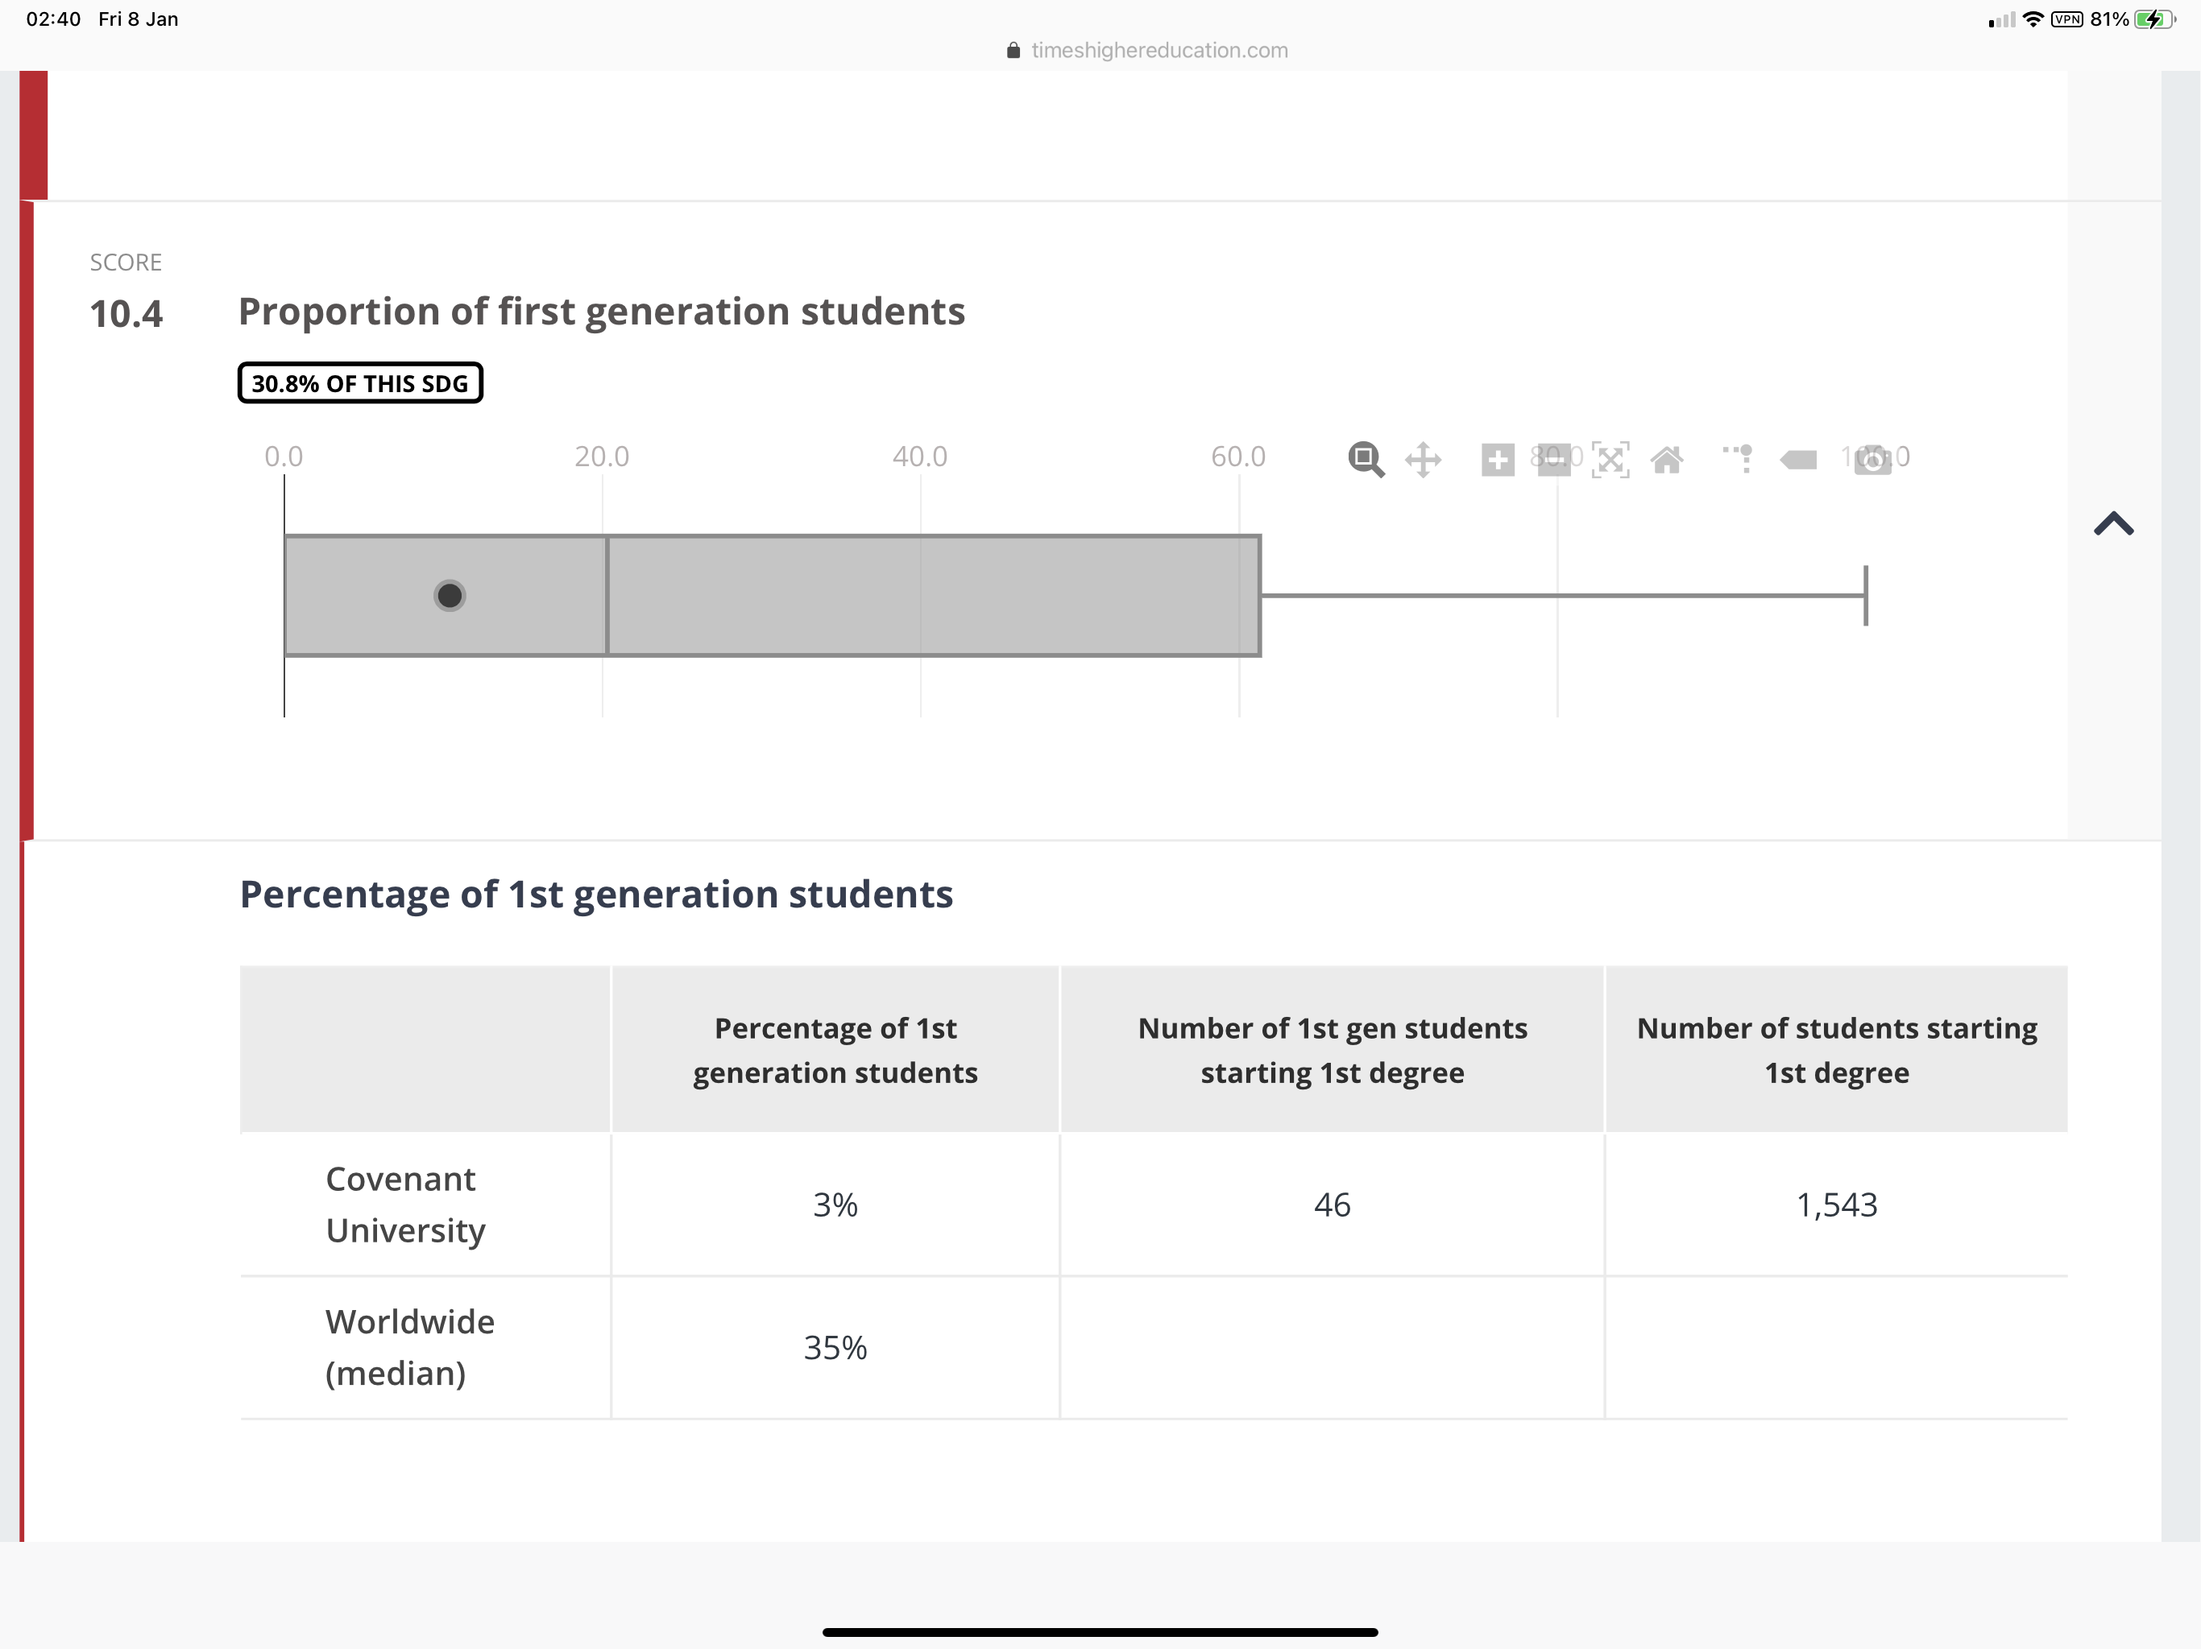
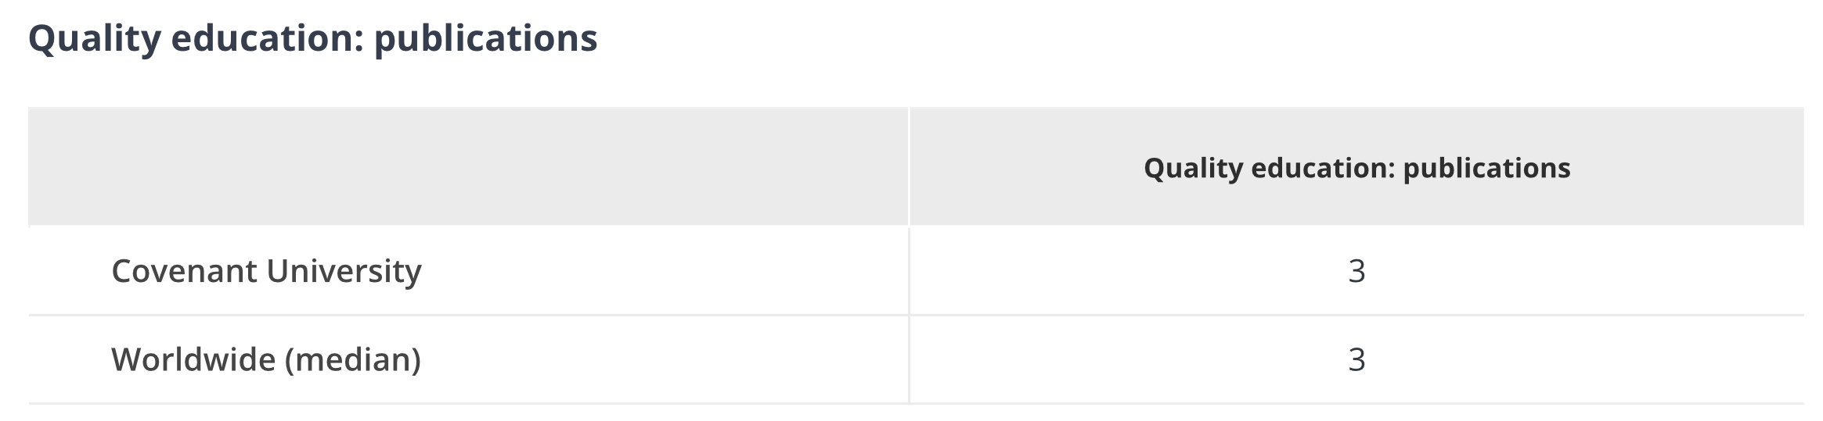

Slide 19
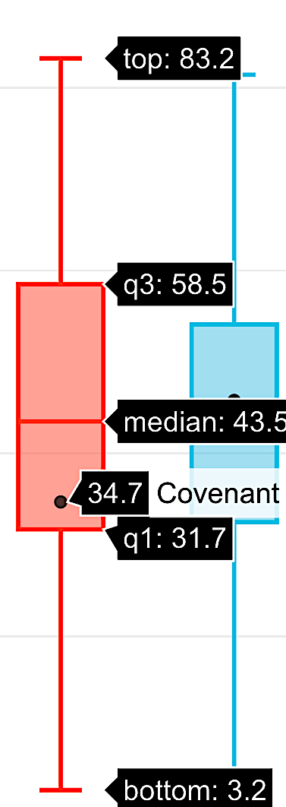
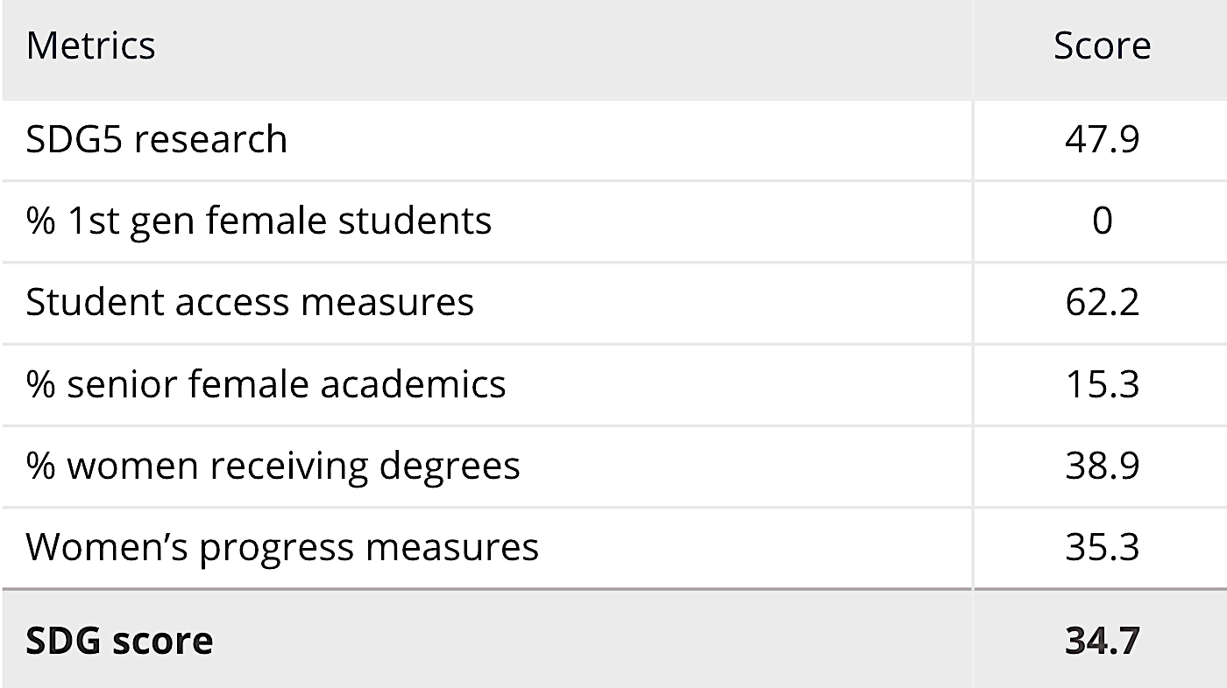




Slide 20




Slide 21






Slide 22




Slide 23






Slide 24





Slide 25






Slide 26




Slide 27






Slide 28





Slide 29






Slide 30




Slide 31






Slide 32



Slide 33






Slide 34


Slide 35














Slide 36
Concluding Recommendations
THE SDG Impact Rankings (IR) may become a veritable conduit for the attainment of Vision 10:2022 for the following reasons:
The Impact Rankings is premised on the UN Sustainable Development Goals
The SDGs have globally recognised metrics for assessing the societal impact of Organisations, Institutions and Countries towards the realisation of the future we aspire to achieve.
Unlike the other THE Rankings which focus majorly on research, the IRs measure the socio-economic and sundry effects of Research endeavours on society
The SDG metrics are more objective and all-encompassing
The Rankings’ focus on impact resonates strongly with Covenant’s founding departure philosophy, with a focus on Research for Development
Covenant emerged 401-600 in THE University Impact Rankings 2020

Slide 37


