Slide 1
AUDIT AND ASSURANCE: A PRACTICAL APPROACH
Being a Paper presented by Ifeanyi Mba, Managing Partner, MBA & CO (Chartered Accountants), to 400 Level Accounting Students of Covenant University, Canaanland, Ota, Ogun State.
dated January 21, 2015

Slide 2
This Paper covers the following areas:
An Overview of Audit and Assurance: Past to Present
Flowchart Discussion on Practical Audit Business Procedures
Workshop and Simulated Practicals (including Cases )

Slide 3
An Overview of Audit and Assurance: Past to Present
Audit is a latin word, meaning ‘he hears’. This can be stretched into a modern sense of Auditing which is a process usually carried out by suitably qualified auditors (i.e, qualified chartered accountants), whereby the accounts of business entities, including Companies, Professional Firms, Partnerships, Sole Proprietorships, Governmental and Non-Governmental institutions and establishments, etc, are subjected to scrutiny in such details as will enable the auditors to form an opinion ( not issue certificate) as to their accuracy, truth and fairness.

Slide 4
This opinion is then embodied in what we call INDEPENDENT AUDITORS’ REPORT (in respect of statutory audits) and INTERNAL AUDITORS’ REPORT ( in case of Internal Audit routinary duties), and addressed to those interested parties who commissioned the audit, or to whom the auditors are answerable and responsible to under Statute (e.g, Companies and Allied Matters Act, Cap.C.20, LFN, 2004), and/or in discharge of employment duties, respectively.

Slide 5
From the foregoing, the auditors will normally express whether in their ‘opinion the financial statements of such organisations are true and fair’ and or …present fairly, in all material respects, the financial position of the Company…’. And this can only be done after the auditor has satisfied himself that various Accounting and Auditing Standards, Ethical and relevant Statutory requirements, amongst others, have been fully observed. And recent times there has been increasing concern with deontology that looks beyond clearly defined rules of law to adoption of moral principles which is the foundation of jurisprudence. The recognition that decisions often imply moral choice broadens the perspective on the nature of choice and limits of choice in ethical considerations in the work of an auditor.

Slide 6
Sequel to these, it should be noted that moral hazard has become a major consideration in dealing with the failure of the regulatory framework in preventing corruption and fraud that have led to massive financial corporate scandals that have tarnished the reputation of top executives and their institutions in both the private and public sectors and not sparing auditors across Nigeria and internationally.
Yes, ethical values such as truth, sincerity, fairness, care and transparency, are considered fundamental for creating trust in both the accounting and auditing profession and then in the information provided users of accounting information.

Slide 7
Auditing, yielding ‘audited info’ and results, has continued to add further quality and acceptability to …’he hears…’ and their importance goes beyond the confines of market economy driven profitability and increases in dividend to shareholders to question of sustainability of social order and discipline on how the resultant effects are able to deal with the frightening array of problems now facing humanity in the areas of poor-quality output and ‘recall of products’, massive corruption in high places, global syndicated frauds, and brazen thefts in colossal magnitudes, etc, involving government officials, businessmen/women, their associates, cohorts and cliques.

Slide 8
Further legislations and standardization of practices of auditing have been put in place in recent times to enhance quality of audit service delivery to yield audit and assurance services both locally and internationally.
In Nigeria, the Financial Reporting Council of Nigeria Act, 2011, is passed into law, and in United States of America, Sarbanes-Oxley Act, 2002, was also passed into law by the 107th Congress of the USA, with its full description titles as:

Slide 9
Public Company Accounting Reform and Investor Protection Act, 2002;
Corporate and Criminal Fraud Accountability Act, 2002;
White Collar Crime Penalty Enhancement Act, 2002;
and SOX for short abbreviation.

Slide 10
Therefore, Sox, is designed to improve quality and transparency in financial reporting and independent audits and accounting services for public companies, to create a Public Company Accounting Oversight Board, to enhance the Standard Setting Processes for accounting practices, to strenghten the independence of firms that audit public companies, to increase corporate responsibility and the usefulness of corporate financial disclosures, to protect the objectivity and independence of securities analysts, to improve Securities and Exchange Commission resources and oversight functions, and for other purposes.
And its worthy to note what President George W. Bush, commented when he signed the Sox Bill into law:

Slide 11
‘My administration pressed for greater corporate integrity. A united Congress has written it into law. And today I sign the most far reaching reforms of American business practices since the time of Franklin Delano Roosevelt. This new law sends very clear messages that all concerned must heed. This law says to every dishonest corporate leader: you will be exposed and punished; the era of low standards and false profits is over; no boardroom in America is above or beyond the law.

Slide 12
This law says to honest corporate leader: your integrity will be recognized and rewarded, because the shadow of suspicion will be lifted from good companies that respect the rules. This law says to corporate accountants: the high standards of your profession will be enforced without exception; the auditors will be audited: the accountants will be held to account.
This law says to shareholders that the financial information you receive (...he hears ) from a Company will be true and reliable; for those who deliberately sign their names to deception will be punished.

Slide 13
This law says to workers: we will not tolerate reckless practices that artificially drive up stock prices and eventually destroy the companies, and the pensions and your jobs. And this law says to every American: there will not be a different ethical standard for corporate America than the standard that applies to everyone else. The honesty you expect in your small businesses or in your workplaces, in your community or in your home, will be expected and enforced in every corporate suite in this country.
(Office of the Press Secretary of the President of the US, June 30, 2002).

Slide 14
In Nigeria, the equivalent of SOX, is FRC, The Financial Reporting Council of Nigeria, established under Financial Reporting Council of Nigeria Act No.6, 2011. Under this law, FRC, has power to enforce and approve enforcement of compliance with Accounting, Auditing, Corporate Governance and Financial Reporting Standards in Nigeria, amongst others, in line with International Standards, like International Financial Reporting Standards (IFRS), International Standards on Auditing (ISAs); International Standard on Assurance Engagements (ISAE) and including the international strict Rules and Laws of Corporate Governance, like SOX.

Slide 15
Under FRC all professionals are required to register with it and obtain an FRC Number before commencing any works or assignments for Public Interest Entities, PIE( i.e, governments, government organizations, quoted and unquoted companies and all other organizations which are required by law to file returns with regulatory authorities and this excludes private companies that routinely file returns only with the Corporate Affairs Commission and the Federal Inland Revenue Service)and also all directors, especially executive directors, of such entities are mandated to do likewise and both the professionals and directors must

Slide 16
state their names, professional body they belong and their FRC No. on any documents they sign on behalf of the PIE; FRC Law also defines Corporate Governance as the roles of persons entrusted with the supervision, control and direction of an entity in Nigeria, and Financial Reporting Standards to mean: Accounting, Auditing, Actuarial, Valuation, Standards issued by FRC.

Slide 17
The functions of the FRC are enumerated in Section 8, FRCN Act 2011, and include ‘to develop and publish accounting and financial reporting standards including monitoring for compliance of same; receive copies of annual reports of and financial statements of PIEs from preparers within 60 days of the approval by the Board and review same; promote compliance with adopted standards issued by International Federation of Accountants and International Accounting Standards Board; amongst numerous other functions enumerated in this section 8.

Slide 18
So it can be seen that both the FRC and SOX seek to achieve same values, targets and objectives, viz, security, reliability, safety, etc, in the use of information derived from financial statements of organizations, for best quality service delivery to end users (…he hears ).

Slide 19
Relevant Standards
Audit & Assurance Services

Slide 20
International Standards on Auditing (ISAs)
IAS 200 Overall Objectives of the Independent Auditor and the Conduct of an Audit in Accordance with ISAs.
ISA 210 Agreeing the Terms of Audit Engagements
ISA 230 Audit Documentation
ISA 240 The Auditor’s Responsibilities Relating to Fraud in an Audit of Financial Statements
ISA 250 Consideration of Laws and Regulations in an Audit of Financial Statement
ISA 260 Communication with those charged with governance
ISA 265 Communicating Deficiencies in Internal Control to Those Charged with governance and management
ISA 300 Planning an Audit of Financial Statement

Slide 21
ISA 315 Identifying and assessing the Risks of Material Misstatement through understanding the entity and its environment
ISA 320 Materiality in Planning and Performing an Audit
ISA 330 The Auditors Responses to Assessed Risks.
ISA 402 Audit Considerations Relating to an Entity Using a Service Organization
ISA 450 Evaluation of Misstatements Identified During the Audit
ISA 500 Audit Evidence
ISA 501 Audit Evidence- Specific Consideration for Selected Items
ISA 505 External Confirmations
ISA 510 Initial Audit Engagements – Opening Balances
ISA 520 Analytical Procedures
ISA 530 Audit Sampling

Slide 22
ISA 540 Auditing Accounting Estimates , including Fair Value Accounting Estimates and Related Disclosures
ISA 560 Subsequent Events
ISA 570 Going Concern
ISA 580 Written Representations
ISA 610 Using the Work of Internal Auditors
IAS 620 Using the work of an Auditor’s Expert
IAS 700 Forming an Opinion and Reporting on Financial Statements
IAS 705 Modifications to the Opinions In the Independence Auditor’s Report
IAS 706 Emphasis of Matter Paragraphs and other Matter Paragraphs in the Independent Auditor’s Report

Slide 23
IAS 710 Comparative Information – Corresponding Figures and Comparative Financial Statements
IAS 720 The Auditor’s Responsibilities Relating to Other Information in Documents Containing Audited Financial Statements
International Auditing Practice Statements (IAPSs)
IAPS 1000 Inter-bank Confirmation Procedures
IAPS 1013 Electronic Commerce : Effect on the Audit of Financial Statements

Slide 24
International Standards on Assurance Engagements ( ISAE)
ISAE 3000 - Assurance Engagements other than Audits or Review of Historical Financial Information

Slide 25
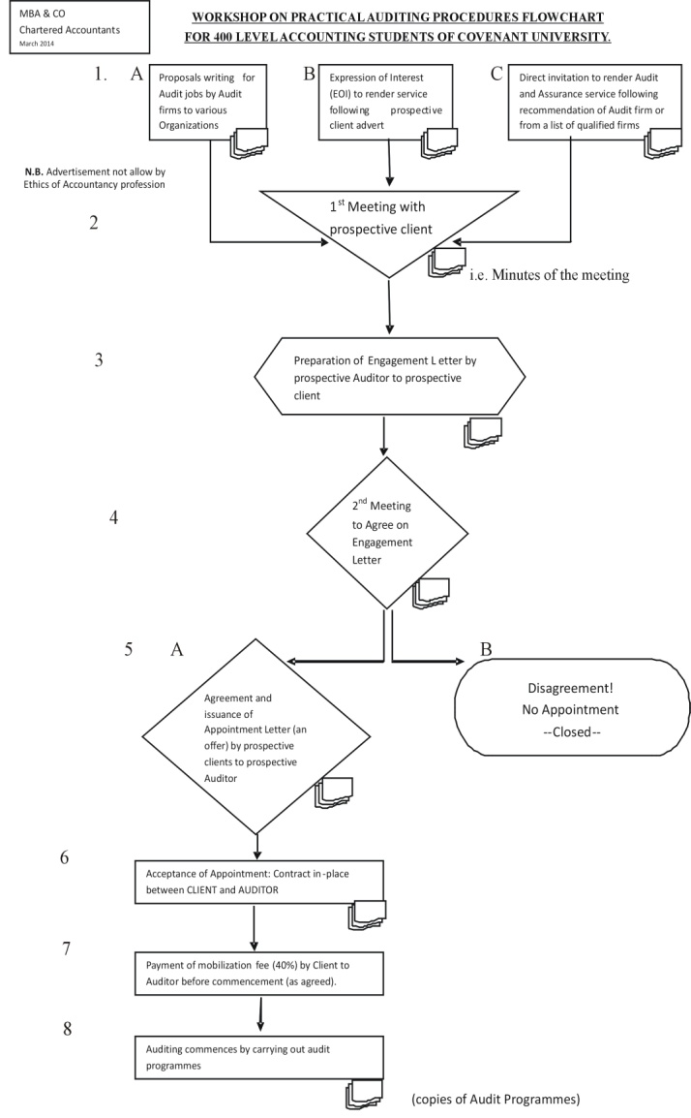
II: Flowchart Discussion on Practical Audit/Assurance Business Procedures

Slide 26
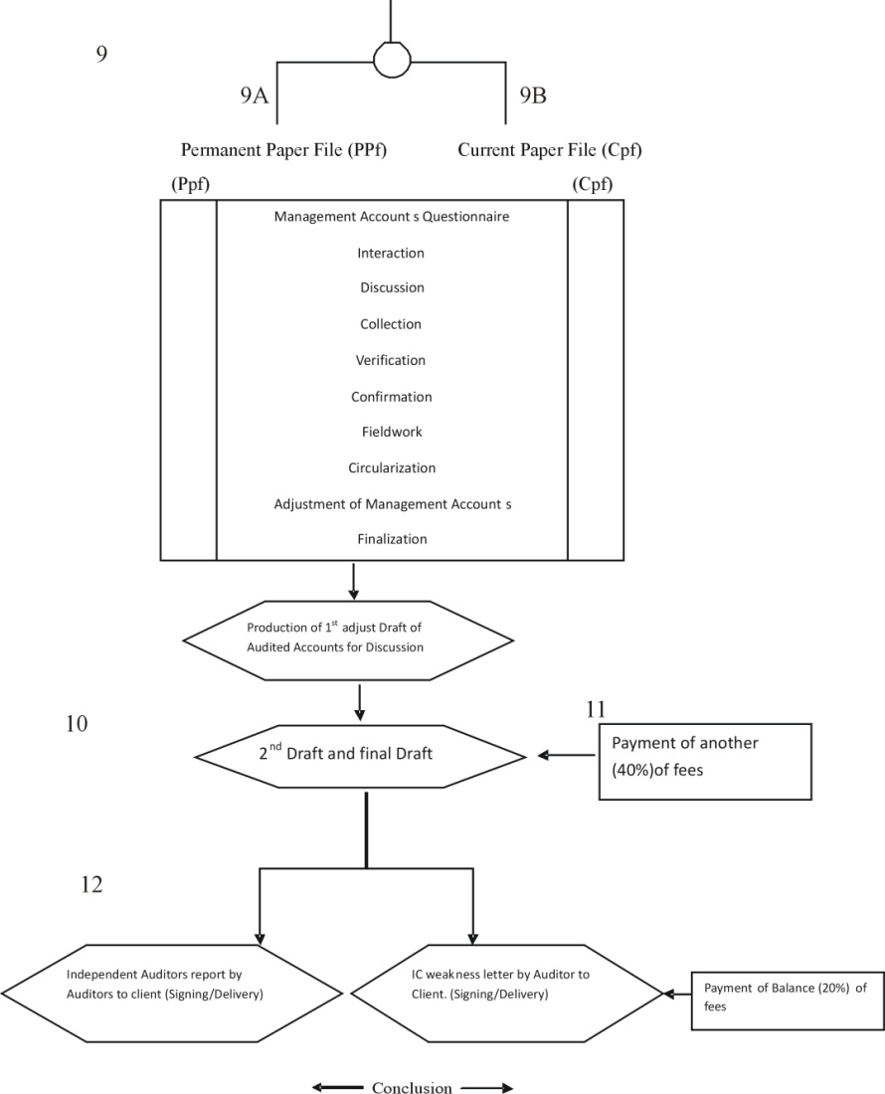

Slide 27
Discussion and presentation session on nodes 1. to 4.
And notice and explain that Engagement Letter should clearly delineate between Audit & Assurance Services, and Accounting and Management Consultancy /Company Secretarial Services.
Sample of Engagement Letter is on page ……..below

Slide 28
SPECIMEN LETTER OF ENGAGEMENT FOR COMPANY CLIENT
MBA & CO
Chartered Accountants 41, Abraham Akinola Street Ikeja, Lagos
Managing Director Date: March 13, 2014
Aniogu Tete Co. Limited
21 Silver Way
Abuja, FCT
Dear Sir, ENGAGEMENTS FOR AUDIT AND ASSURANCE SERVICES
We wish to refer to the business Meeting between your goodself and our managing partner on February 10, 2014, in respect of the above subject matter at your above mentioned office and hereby present our understanding of what you will want us to do for your company. This also includes our statutory duties under relevant laws of Nigeria in connection with audit of your financial statements.
Set out below are the basis on which we (are to) act as auditors of the company (and its subsidiaries) and the respective areas of responsibility of the company and ourselves.

Slide 29
1 . Audit and Assurance
1.1 As Directors of the above company, you are responsible for maintaining proper accounting records and preparing financial statements which give a true and fair view and comply with the Companies and other relevant Laws. You are also responsible for making available to us , as and when required , all the company’s accounting records and all other records and related information , including minutes of all management and shareholders’ meetings.
1.2 We have a statutory responsibility to report to the members whether in our opinion the financial statements give a true and fair view of the state of your company’s affairs and of the profit or loss for the year and whether they comply with the relevant Laws. In arriving at our opinion, we are required to consider the following matters , and to report on any, in respect of which we are not satisfied :

Slide 30
(a) whether proper accounting records have been kept by the company and proper returns adequate for our audit have been received from branches not visited by us:
(b) whether the company’s Statement of Financial Position and Comprehensive Income Statement are in agreement with the accounting records and returns:
(c) whether we have obtained all the information and explanation which we think are necessary for the purpose of our audit; and (d) whether the information in the directors report is consistent with that in the audited financial statements.

Slide 31
In addition, there are certain other matters which, according to circumstances may be dealt with in our report. For example, where the financial statements do not give full details of directors’ remuneration or of their transaction with the company, the companies Act requires us to disclose such matters in our report.
1.3 We have a professional responsibility to report if the financial statements do not comply in any material respect with Financial Reporting Standards in satisfaction of The Financial Reporting Council of Nigeria Act, 2011, unless in our opinion the non –compliance is not justified in the circumstances.

Slide 32
1.4 Our audit will be conducted in accordance with the International Auditing Standards issued by the International Auditing and Assurance Standards Board (IAASB) and will have regard to relevant Auditing Guidelines and Exposure Drafts, as appropriate. Furthermore, it will be conducted in such a manner as we consider necessary to fulfill our responsibilities and will include such test of transactions and of the existence, ownership and valuation of assets and liabilities as we consider necessary. We shall obtain an understanding of the accounting system in order to assess its adequacy as a basis for the preparation of the financial statements and to establish whether proper accounting method have been maintained .

Slide 33
We shall expect to obtain such relevant and reliable evidence as we consider sufficient to enable us to draw reasonable conclusions there from. The nature and extent of our tests will vary according to our assessment of the company’s account system and, where we wish to place reliance on it, the system of internal control as it may relate any aspect of the business operations. We shall report to you any significant weaknesses or observations on, the company’s systems which come to our notice and which we think should be brought to your attention.

Slide 34
1.5 As part of our normal audit procedures, we may request you to provide written confirmation of oral representations which we have received from you during the course of the audit.
1.6 In order to assist us with the examination of your financial statements, we shall request sight of all documents or statements, including the Chairman’s Statements and the Directors’ Report; as you know, we are also entitled to attend all general meeting of the company and to receive notices of all such meetings.

Slide 35
1.7 [where appropriate] We appreciate that the present size of your business renders it uneconomic to create a system of internal control based on segregation of duties for different functions within each area of the business. In planning and performing our audit work we shall take account of this supervision. Further, we may ask additionally for confirmation in writing that all the transactions undertaken by the company have been properly reflected and recorded in the accounting records, and our audit report on your company’s financial statements may refer to this confirmation.

Slide 36
1.8 The responsibility for the prevention and detection of irregularities or fraud rests with yourselves. However, we shall endeavour to plan our audit so that we have a reasonable expectation of detecting material misstatements in the financial statement or accounting records resulting from irregularities or , fraud, but our examination should not be relied upon to disclose irregularities and fraud which may exist.
1.9 [Where appropriate] We shall not be treated as having notice , for the purpose of our audit responsibilities information provided to members of our firm other than those engaged on the audit.

Slide 37
2 . Accounting and Other Services
It should be noted that Accounting, Taxation, Business Purchase Investigation, Other Investigations, Preparation of Prospectus, including Feasibility Study on Projects, Operations or Documentations Procedures, etc, are outside Audit Services. Those will be covered under Special Consultancy Engagements. During the Meeting, we discussed we should do the following:-
2.1 Review the Accounting and Internal Control System presently in operation in your Company and Prepare the financial statements based on accounting records maintained by yourselves ;

Slide 38
2.2 Provide assistance to the Company Secretary by preparing and lodging Returns with the Registrar of Companies at Corporate Affairs Commission, Abuja;
2.3 Investigate Irregularities and Fraud, especially involving your Off-shore accounts and returns;
2.4 Prepare Tax Computations and procure Tax Clearance Certificates ( TCC);
2.5 Prepare Company Profile and Package you for Contract Bidding Processes;
2.6 Verify and Attest on Banji Enterprises Limited valuation and fitness to partner with your Company.

Slide 39
All the matters numbered 2.1 to 2.6 above come within areas of our specialization and competence but will be covered under a separate Appointment Letter different from Offer Letter for Audit Services in 1. above .

Slide 40
3.0 Reporting
At the conclusion of the exercises in 1. And 2. above, separate Reports will be issued as follows:
Independent Auditors’ Report
- - for Audit & Assurance Services
Management Letter and Other Services Report
- - for Accounting and Other Services

Slide 41
4. Fees
Our fees will be based on the Scale of Fees prevalent in the Accountancy Profession, and scheduled under IFAC Standards (IFAC is International Federation of Accountants).Reference should be made to Approved Scale of Fees of the Institute of Chartered Accountant of Nigeria, ICAN: 2011 (current scale), especially where negotiations are made outside the strict rules of the Scale. Ref: www.ican-ngr.org

Slide 42
5. Agreement and Terms
Once it has been agreed , this letter will remain effective , from one audit, etc, appointment to another , until is replaced or modified . We shall be grateful if you could confirm in writing your agreement to the terms of this letter by issuing us APPOINTMENT LETTER (S), or let us know if they are not in accordance with your understanding for necessary adjustments and changes to be made.
We wish to use this medium to express our gratitude to you and your esteemed establishment for finding us worthy to serve.
Yours faithfully,
MBA & CO
Ifeanyi Mba
Managing Partner

Slide 43
Nodes 5 to 6 cover Appointment Letter procedures ( now discussed)
And you are going to prepare Appointment Letter during Workshop Session
Please Note: Companies and Allied Matters Act, Cap. C.20, LFN, 2004, position on Appointment and Removal of Auditors: as below

Slide 44
S. 357. Appointment of auditors
(1) Every company shall at each annual general meeting appoint an auditor or auditors to audit the financial statements of the company and to hold offices from the conclusion of that, until the conclusion of the next , annual general meeting.
(2) At any annual general meeting a retiring auditor , however appointed shall be re-appointed without any resolution being passed unless-
(a) He is not qualified for re-appointment; or
(b) A resolution has been passed at that meeting appointing some other persons instead of him or providing expressly that he shall not be re-appointed; or

Slide 45
(c) He has given the company notice in writing of his unwillingness to be re-appointed: provided that where notice is given of an intended resolution to appoint some person or persons in place of retiring auditor, and by reason of the death , incapacity or disqualification of that person or of all those persons , as the case may be, the resolution cannot be proceeded with the retiring auditor shall not be automatically re-appointed by virtue of this subsection .
(3) where at an annual general meeting, no auditors are appointed or re-appointed, the directors may appoint a person to fill the vacancy.

Slide 46
(4) The company shall , within one week of the power of the directors under subsection (3) of this section becoming exercisable , give notice of that fact to the commission ; and if a company fails to give notice as required by this subsection, the company and every officer of the company who is in default shall be guilty of an offence and liable to a fine on N100. For everyday during which the defaults continues.
(5) Subjects as herein after provided , the first auditors of the company may be appointed by the directors at any time before the company is entitled to commence business and auditors so appointed shall hold office until the conclusion of the next annual general meeting:
provided that-

Slide 47
(a) The company may at a general meeting remove any such auditors and appoint in their place any other person who have been nominated for appointment by any member of the company and of whose nomination notice has been given to the members of the company not less than 14days before the date of the meeting ; and
(b) if the directors fail to exercise their power under the subsection; the company may, in a general meeting convened for that purpose appoint the first auditors and thereupon the said powers of the directors shall cease. (6) The directors may fill any casual vacancy in the office of auditor but while any such vacancy continues, the surviving or continuing auditor or auditors , if any , may act.

Slide 48
S.358. Qualification of auditors.
(1) The provisions of the Institute of Chartered Accountants of Nigeria Act shall have effect in relation to any investigation or audit for the purpose of this Act so however that none of the following persons shall be qualified for appointment as auditor of a company that is –
a. An officer or servant of the company.
b. A person who is a partner of or in the employment of an officer or servant of the company;
c. A body corporate and reference in the subsection of an officer or servant shall be construed as not including references to an auditor.

Slide 49
(2). In the application to subsection (1) of this section , the disqualification shall extend and apply to persons who in respect to any period of an audit where in the employment of the company or where otherwise connected therewith in any manner.
(3) a person shall not qualify for an appointment as an auditor of a company if he is , under subsection (6) of this section , disqualified for appointment as auditor of any other body corporate which is that company subsidiary or holding company or a subsidiary of that company ‘s holding company , or would be so disqualified if the body corporate were a company.

Slide 50
(4) Notwithstanding subsection (1), (2) and (3), of this section , a firm is qualified for appointment as auditor of a company if , but only if, all the partners are qualified for appointment as auditors of it.
(5) No person shall act as auditor of a company at a time when he knows that he is disqualified for appointment to that office and if an auditor of a company to his knowledge becomes so disqualified during his term of office , he shall therefore vacate his office and give notice in writing to the company that he has vacated it by reason of that disqualification.

Slide 51
(6) A person who acts as auditor in contravention of subsection (5) of this section or fails without reasonable excuse to give notice of vacating his office as required by that subsection , shall be guilty of an offence and liable to fine of N500 and , for continued contravention, to a daily default fine of N50.

Slide 52
S.362. Removal of auditors.
(1) A company may by ordinary resolution remove an auditor before the expiration of his term of office , notwithstanding anything in any agreement between it and him.
(2) Where a resolution removing an auditor is passed at a general meeting of a company , the company shall within 14days give notice of that fact in the prescribed form to the commission and if a company fails to give the notice required by this subsection, the company and any office of it who is in default shall be guilty of an offence and liable to a daily default fine of N100.
(3) Nothing in this section shall be taking as depriving a person removed under it of compensation or damages payable to him in respect to the termination of his appointment as auditor or of any appointment terminating with that as auditor.

Slide 53
S. 363. Auditors right to attend company’s meetings.
(1) A company ‘s auditor shall be entitled to attend any general meeting of the company , and to receive all notices of and other communications relating to any general meeting which a member of the company is entitled to receive and to be heard at any general meeting which they attend on any part of the business of the meeting which concerns them as auditor.
(2) An auditor of a company who has been removed shall be entitled to attend- (a) the general meeting at which his term of office would otherwise have expired; and

Slide 54
(b) any general meeting at which it is proposed to fill the vacancy caused by his removal; and to receive all notices of , and other communication relating to , any such meeting which any member of the company is entitled to receive , and to be heard at any such meeting which he attends on any part of the business of the meeting which concerns him as former auditor of the company.

Slide 55
S.364. Supplementary provisions relating to auditors
(1) A special notice shall be required for a resolution at a general meeting of a company- (a) appointment as auditor a person other than a retiring auditor or (b) filling a casual vacancy in the office of auditor ;or (c) re-appointing as auditor a retiring auditor who was appointed by the directors to fill a casual vacancy; or (d) removing an auditor before the expiration of his term of office..

Slide 56
(2) On receipt of notice of such an intended resolution as is mentioned in subsection (1) the company shall forthwith send a copy of it - (a) To the person proposed to be appointed or removed , as the case may be; (b) In a case within subsection (1) (a), of this section to the retiring auditors; and (c) where, in a case within subsection (1)(b)or(c), of this section , the casual vacancy was caused by the resignation of an auditor , to the auditor who resigned.

Slide 57
(3) Where notice is given to such resolution as is mentioned in subsection (1) (a) or (d) of this section and the retiring auditor or (as the case may be the auditor proposed to be removed) makes with respect to the intended resolution representations in writing to the company not exceeding a reasonable length and request their notification to members of the company , the company shall (unless the representations are received by it too late for it to do so)-
(a) In any notice of the resolution given to members of the company state the fact of the representations having been made ;and (b) send a copy of the representations to every member of the company to whom notice of the meeting is or has been sent.

Slide 58
(4) If a copy of any representation is not sent out as required by subsection (3) of this section because they were received too late or because of the company’s default , the auditor may (without prejudice to his right to be heard orally) require that the representation shall be read out at the meeting.
(5) Copies of the representations need not be sent out and the representations needs to be read out at the meeting if , on the application either of the company or of any other person claiming to be aggrieved , the court is satisfied that the rights conferred by this section are being abused to secure needless publicity for defamatory matter; and the court may order the company’s cost on the application to be paid in whole or in part by the auditor , notwithstanding that he is not a party to the application.

